Slide 1
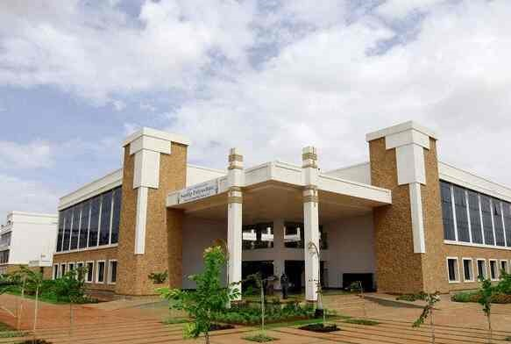
Volume 01 Issue 04
SANDIP POLYTECHNIC
March - April 2023
NEWSLETTER
Vision of Sandip Polytechnic
“To produce skilled technocrats for serving industry, Society and pursue higher education”
Mission of Sandip Polytechnic
M1 : State the art of infrastructure, qualified and competent teaching faculty.
M2 : To provide industry institute interaction, employability enhancement and higher education.
M3 : To provide platform for development professional, social skill and life long learning.
Vision and Mission of the Department
VISION:
To produce professional skilled civil engineers to face the challenges in the engineering field and pursue higher education.
MISSION:
M1: To provide quality infrastructure in the support of a conducive learning environment.
M2: To inculcate the practices towards employability, entrepreneurship and higher education.
M3: To develop a positive attitude, professional and social skills
Leading Polytechnic
College s in Nashik
When you join Sandip Polytechnic (SP) at Sandip Foundation, you are joining one of the top polytechnic colleges in Maharashtra and indeed the best polytechnic college in Nashik.
If you want to fast track your career and fast track yourself to success then there’s just one and only one place and that’s Sandip Polytechnic. Our motivation to help you become ‘insanely’ great at what you do, achieve your imagination.
Editorial Board Members
Prof. V. O. Patil
Prof. B. G. Abhale

Slide 2
Volume 01 Issue 04
Vision and Mission of the Department
VISION:
To produce professional skilled civil engineers to face the challenges in the engineering field and pursue higher education.
MISSION:
M1:To provide quality infrastructure in the support of a conducive learning environment.
M2:To inculcate the practices towards employability, entrepreneurship and higher education.
M3:To develop a positive attitude, professional and social skills
WHAT’S INSIDE
02. HOD Message
03. Editors Information
04. About Civil Department
05. Lab Information
06. Toppers
07. Expert Lecture
08. Two days FDP
01. Chairman’s Message
09. Students Corner

Slide 3
Volume 01 Issue 04
Vision and Mission of the Department
VISION:
To produce professional skilled civil engineers to face the challenges in the engineering field and pursue higher education.
MISSION:
M1:To provide quality infrastructure in the support of a conducive learning environment.
M2:To inculcate the practices towards employability, entrepreneurship and higher education.
M3:To develop a positive attitude, professional and social skills
Learn from your experiences for these is no greater tutor than life itself.
From Chairman’s Desk
Learn from your experience, for there is no greater tutor than life itself. I am happy to pen down a few words as prologue to our Newsletter which is exclusively meant for churning out the latent writing talent which bears immense potentiality of sharpening our students’ skills as part of their overall personality development. I congratulate all the team members and contributors of this Newsletter for bringing out such a beautiful Newsletter. Walk with those who feed your mind with motivation to further your mission. Wake up hungry for success every day; your drive for success must match the ferocity of a hungry lion attacking his prey every morning. An educated person without morals is like a room without windows. I think that morals are what ground us as a society, and without morals we would have no light to guide our educated minds. We, at Sandip Foundation, strive to make our students reliable technocrats and trustworthy citizens of India. My staunch faith and conviction is that our students would carve a niche in their career and life by going lineage and heritage through this temple of learning. I would like to take this opportunity to reiterate that there is no substitute to hard work in any venture. Therefore, it should be our endeavor to give our best in our areas of responsibilities and aim at achieving excellence for our institution. I wish all success to this venture.
HON’BLE DR. SANDIP N. JHA
Chairman, Sandip Foundation

Slide 4
Volume 01 Issue 04
Vision and Mission of the Department
VISION:
To produce professional skilled civil engineers to face the challenges in the engineering field and pursue higher education.
MISSION:
M1:To provide quality infrastructure in the support of a conducive learning environment.
M2:To inculcate the practices towards employability, entrepreneurship and higher education.
M3:To develop a positive attitude, professional and social skills
HOD Civil Engineering Department Massage
From HOD’s Desk
I welcome you all to Sandip Polytechnic, the institution which has set the benchmark for quality teaching learning process. The institute strives to provide the world class faculties and facilities so that we will see you all blossom into empowered and sensitive human being. Education is the manifestation of love and my most cherished possession. It drives away the ignorance and through illumination it emboldens a man to a righteous thought and action. It energizes a society and enables a man to earn his living with respect and praise. In order to accomplish our vision and mission, we are prepared to take as much effort as possible for the betterment of academic scenario in India. Our institute cares for the individual development of each and every student. We follow the mentor system under which each class is put into multi-prolonged web of a teacher. We accord prime importance to the behavioral discipline, moral integrity and cognitive developments of our students. Our faculties strive to teach not only academic programs but also life skills needed for students.
Dr. Prof. VILAS NIKAM,
Vice Principal HODCE

Slide 5
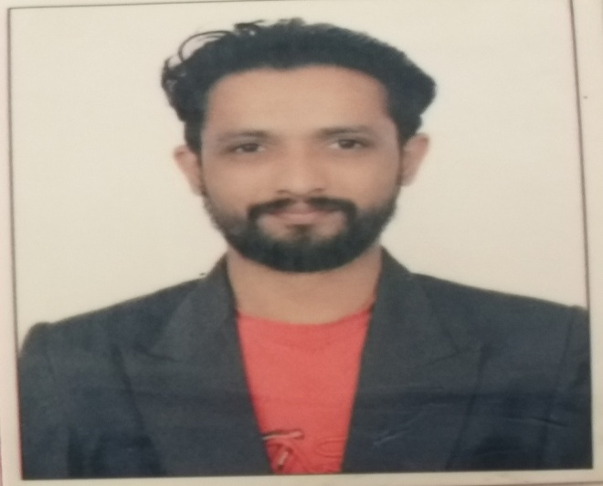
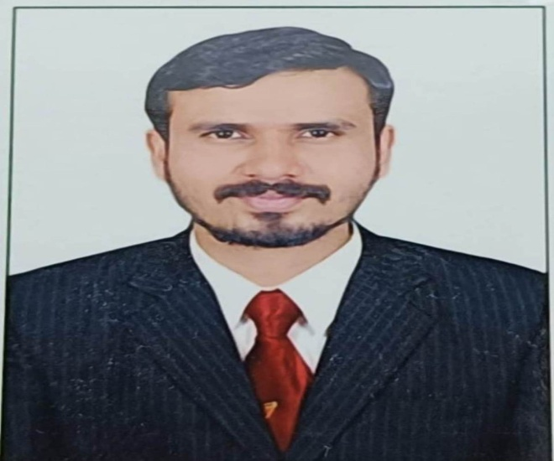
Volume 01 Issue 04
Vision and Mission of the Department
VISION:
To produce professional skilled civil engineers to face the challenges in the engineering field and pursue higher education.
MISSION:
M1:To provide quality infrastructure in the support of a conducive learning environment.
M2:To inculcate the practices towards employability, entrepreneurship and higher education.
M3:To develop a positive attitude, professional and social skills
Editors Information
Prof. V. O. Patil
ME (Structure)
vikas.patil@sandippolytechnic.org
9511940099
Prof. B. G. Abhale
ME (Environment)
bhanudas.abhale@sandippolytechnic.org
9423042624

Slide 6
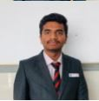
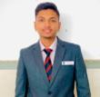
Volume 01 Issue 05
Vision and Mission of the Department
VISION:
To produce professional skilled civil engineers to face the challenges in the engineering field and pursue higher education.
MISSION:
M1:To provide quality infrastructure in the support of a conducive learning environment.
M2:To inculcate the practices towards employability, entrepreneurship and higher education.
M3:To develop a positive attitude, professional and social skills
Students Details FY-SY-TY
NIKHIL DHANJAY PATIL
OMKAR RAJENDRA GAIKWAD

Slide 7
Volume 01 Issue 04
Vision and Mission of the Department
VISION:
To produce professional skilled civil engineers to face the challenges in the engineering field and pursue higher education.
MISSION:
M1:To provide quality infrastructure in the support of a conducive learning environment.
M2:To inculcate the practices towards employability, entrepreneurship and higher education.
M3:To develop a positive attitude, professional and social skills
Students Details FY-SY-TY
NIKHIL DHANJAY PATIL
OMKAR RAJENDRA GAIKWAD

Slide 8
Volume 01 Issue 04
Vision and Mission of the Department
VISION:
To produce professional skilled civil engineers to face the challenges in the engineering field and pursue higher education.
MISSION:
M1:To provide quality infrastructure in the support of a conducive learning environment.
M2:To inculcate the practices towards employability, entrepreneurship and higher education.
M3:To develop a positive attitude, professional and social skills
About Civil engineering department
Civil Engineering is a Professional Engineering discipline that deals with the design, construction and maintenance of the physically and naturally built environment, including works such as bridges, roads, canals, dams and buildings. Civil Engineering is the oldest Engineering Discipline after Military Engineering. It is traditionally broken into different disciplines including Environmental Engineering, Structural Engineering, Transportation Engineering, Water Resource Engineering, Geo-technical Engineering, Material Engineering, Survey Engineering and Construction Engineering. Civil Engineering takes place at all levels in the public sector and private sector.
Department Information
Programme:- Civil Engineering
Year of Establishment:- 2009
Intake Capacity:- 120
General Choice Code:- 525819110
TFWS Choice Code:- 525819111T

Slide 9
Volume 01 Issue 04
Vision and Mission of the Department
VISION:
To produce professional skilled civil engineers to face the challenges in the engineering field and pursue higher education.
MISSION:
M1:To provide quality infrastructure in the support of a conducive learning environment.
M2:To inculcate the practices towards employability, entrepreneurship and higher education.
M3:To develop a positive attitude, professional and social skills
Civil engineering LAB Details
Sr. No. | Name of Lab | Location | Cost of Lab
1 | Mechanics of Structure Lab | Ground Floor | 1082264
2 | Hydraulics Lab (Fluid Mechanics) | Ground Floor | 256497
3 | Geotechnical Engineering Lab | Ground Floor | 632350
4 | Concrete Technology Lab | Ground Floor | 845622
5 | Surveying Lab | Ground Floor | 1201804
6 | Public Health Engineering Lab | First Floor | 199615
7 | Model Lab | First Floor | 183141
8 | Engineering Mechanics Lab | First Floor | 314878
9 | Highway Engineering Lab | First Floor | 108821
10 | CAD Lab | First Floor | --

Slide 10
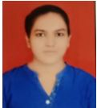
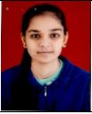
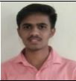
Volume 01 Issue 04
Vision and Mission of the Department
VISION:
To produce professional skilled civil engineers to face the challenges in the engineering field and pursue higher education.
MISSION:
M1:To provide quality infrastructure in the support of a conducive learning environment.
M2:To inculcate the practices towards employability, entrepreneurship and higher education.
M3:To develop a positive attitude, professional and social skills
Civil engineering Toppers TYCE W-22
Sr. No | Name of Student | Enrolment No | Class | % | Photos
01 | CHAVAN TEJASWINI ARUN | 2011670158 | TYCE | 89.70
02 | SURYAWANSHI HARSHAD KEDA | 2011670266 | TYCE | 87.60
03 | SAKSHI SHARAD SHINDE | 2111670494 | TYCE | 81.10

Slide 11
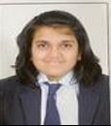
Volume 01 Issue 04
Vision and Mission of the Department
VISION:
To produce professional skilled civil engineers to face the challenges in the engineering field and pursue higher education.
MISSION:
M1:To provide quality infrastructure in the support of a conducive learning environment.
M2:To inculcate the practices towards employability, entrepreneurship and higher education.
M3:To develop a positive attitude, professional and social skills
Civil engineering Toppers SYCE w-22
Sr. No | Name of Student | Enrolment No | Class | % | Photos
1 | GAIKWAD OMKAR SANTOSH | 2111670120 | SYCE | 85.11
2 | PATIL NIKHIL DHANANJAY | 2111670001 | SYCE | 80.56
3 | DANDGAVAL POOJA MANOJ | 2111670119 | SYCE | 76.78

Slide 12
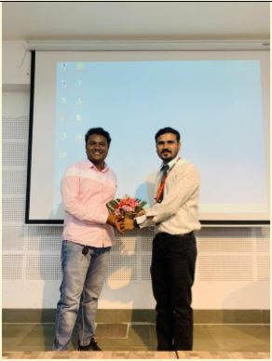
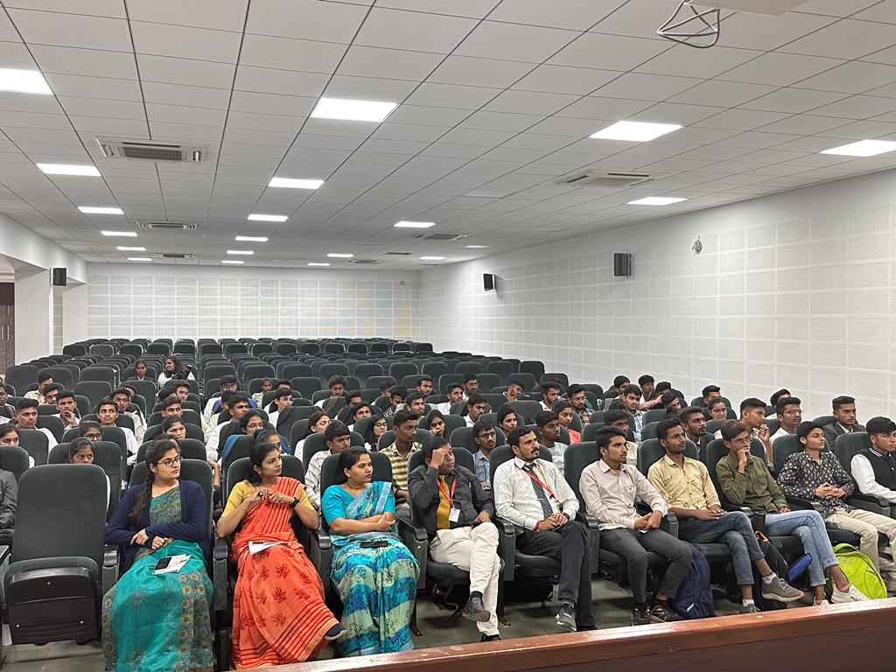
Volume 01 Issue 04
Vision and Mission of the Department
VISION:
To produce professional skilled civil engineers to face the challenges in the engineering field and pursue higher education.
MISSION:
M1:To provide quality infrastructure in the support of a conducive learning environment.
M2:To inculcate the practices towards employability, entrepreneurship and higher education.
M3:To develop a positive attitude, professional and social skills
Expert Lectures
Expert Lecture on Opportuinities & Challenges in Goverment Contractorship after Diploma
Name of Event:
Expert Lecture on Opportuinities & Challenges in Goverment Contractorship after Diploma.
Date of Expert Lecture:-
13.04.2023
Resource Person:-
Mr. Gaurav Jadhav
Participants:-
SYCE & TYCE Students
Objectives:-
The guest lecture was about ‘Opportunities and challenges in Government contractor-ship after Diploma’. In his talk, he introduced himself and explained how he achieved these feet in his life. He further explained about How to apply for PWD Govt. license? How to apply for Tender through online mode? Later, he shared his views about life and how to become a govt. contractor.

Slide 13
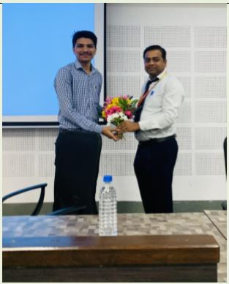
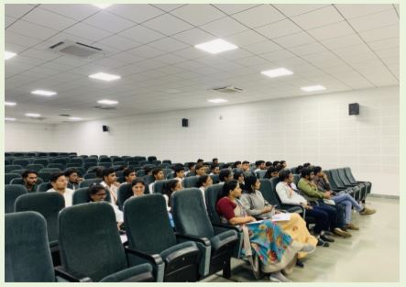
Volume 01 Issue 04
Vision and Mission of the Department
VISION:
To produce professional skilled civil engineers to face the challenges in the engineering field and pursue higher education.
MISSION:
M1:To provide quality infrastructure in the support of a conducive learning environment.
M2:To inculcate the practices towards employability, entrepreneurship and higher education.
M3:To develop a positive attitude, professional and social skills
Expert Lectures
Expert Lecture on E-Tendering & PWD registration
Name of Event:
Expert Lecture on E-Tendering & PWD registration..
Date of Expert Lecture:-
06.04.2023
Resource Person:-
Er. Sumit Bodke
Participants:-
SYCE & TYCE Students
Objectives:-
To make the students aware about online procedure of submitting tender documents.
To get knowledge about PWD registration process.
To know about the tender documents published in newspaper.

Slide 14
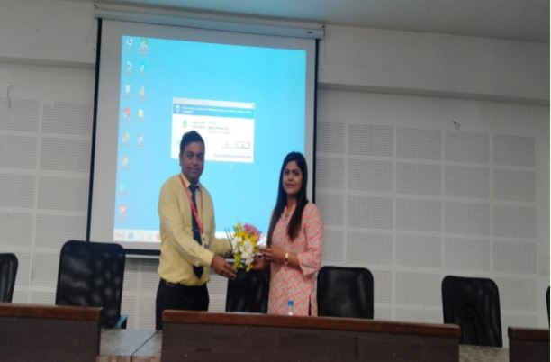
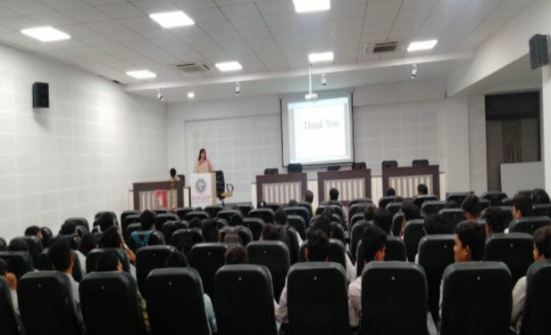
Volume 01 Issue 04
Vision and Mission of the Department
VISION:
To produce professional skilled civil engineers to face the challenges in the engineering field and pursue higher education.
MISSION:
M1:To provide quality infrastructure in the support of a conducive learning environment.
M2:To inculcate the practices towards employability, entrepreneurship and higher education.
M3:To develop a positive attitude, professional and social skills
Expert Lectures
Opportunities in Government Sector for JOB
Name of Event:
Opportunities in Government Sector for JOB..
Date of Expert Lecture:-
17.04.2023
Resource Person:-
Ms. Madhuri Gajanan Lambe
Participants:-
SYCE & TYCE Students
Objectives:-
The main objective of Alumni Guest Lectures is to bring Sandip Polytechnic Alumni to the College Campus to discuss recent breakthroughs and discoveries, offering alumni and friends a chance to share ideas and conversation.
Students get an idea about government jobs and how to apply for jobs.

Slide 15
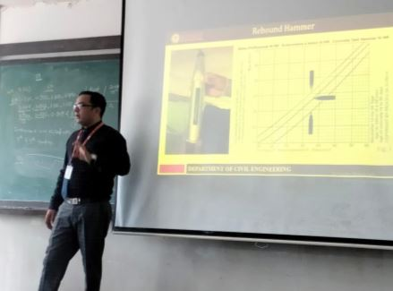
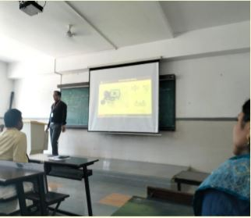
Volume 01 Issue 04
Vision and Mission of the Department
VISION:
To produce professional skilled civil engineers to face the challenges in the engineering field and pursue higher education.
MISSION:
M1:To provide quality infrastructure in the support of a conducive learning environment.
M2:To inculcate the practices towards employability, entrepreneurship and higher education.
M3:To develop a positive attitude, professional and social skills
Expert Lectures
Expert Lecture on Structural Audit
Name of Event:
An Expert Lecture under the subject “Maintenance & Repairs”.
Date of Expert Lecture:-
17.04.2023
Resource Person:-
Prof. R. N. Patil
Participants:-
TYCE Students
Objectives:-
The main objective of an Expert Lecture is to know how the Structural Audit is done at actual.
Instruments used for Non Destructive Testing (NDT).
Sample report format which will shows structure either.

Slide 16
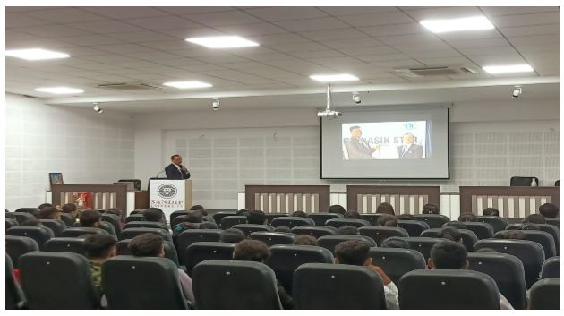
Volume 01 Issue 04
Vision and Mission of the Department
VISION:
To produce professional skilled civil engineers to face the challenges in the engineering field and pursue higher education.
MISSION:
M1:To provide quality infrastructure in the support of a conducive learning environment.
M2:To inculcate the practices towards employability, entrepreneurship and higher education.
M3:To develop a positive attitude, professional and social skills
Expert Lectures
Expert Lecture on Resume Preparation
Name of Event:
An Expert Lecture under the subject “Entrepreneurship Development”.
Date of Expert Lecture:-
21.02.2023
Resource Person:-
Dr. Amol Potgantwar Sir
Participants:-
TYCE Students
Objectives:-
The primary goal of a resume is to showcase your qualifications, including your education, work experience, skills, and accomplishments relevant to the job you're applying for.
Your resume should reflect professionalism in its language, formatting, and content.

Slide 17
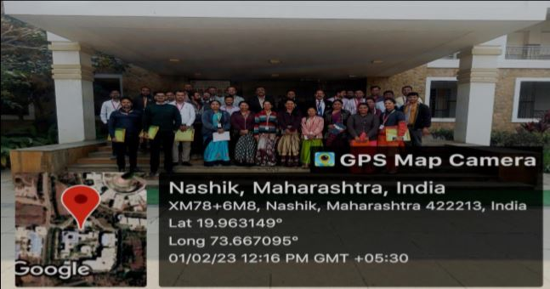
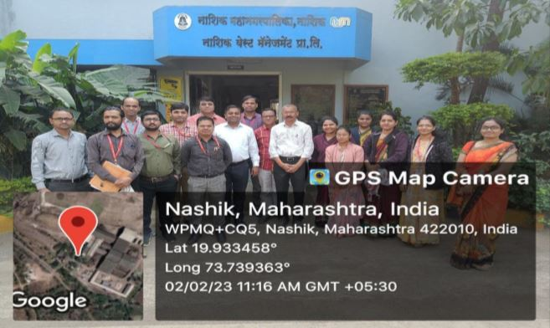
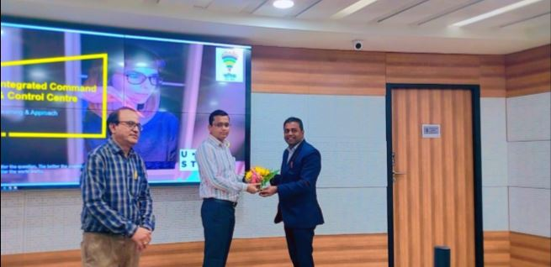
Volume 01 Issue 04
Vision and Mission of the Department
VISION:
To produce professional skilled civil engineers to face the challenges in the engineering field and pursue higher education.
MISSION:
M1:To provide quality infrastructure in the support of a conducive learning environment.
M2:To inculcate the practices towards employability, entrepreneurship and higher education.
M3:To develop a positive attitude, professional and social skills
Two day f.d.p. for staff & students
Challenges & Opportunities in Smart City Development in India
Name of Event:
Challenges & Opportunities in Smart City Development in India. .
Date of Expert Lecture:-
01.02.2023 & 02.02.2023
Location:-
Sandip Polytechnic Building and Nashik Smart City Development office building.
Participants:-
SYCE & TYCE Students & Sandip Polytechnic faculty members
Objectives:-
To create efficiencies, improve sustainability, create economic development, and enhance quality of life factors for people living and working in the city. It also means that the city has a smarter energy infrastructure.
To drive economic growth and improve the quality of life of people by enabling local area development and harnessing technology, especially technology that leads to Smart.

Slide 18

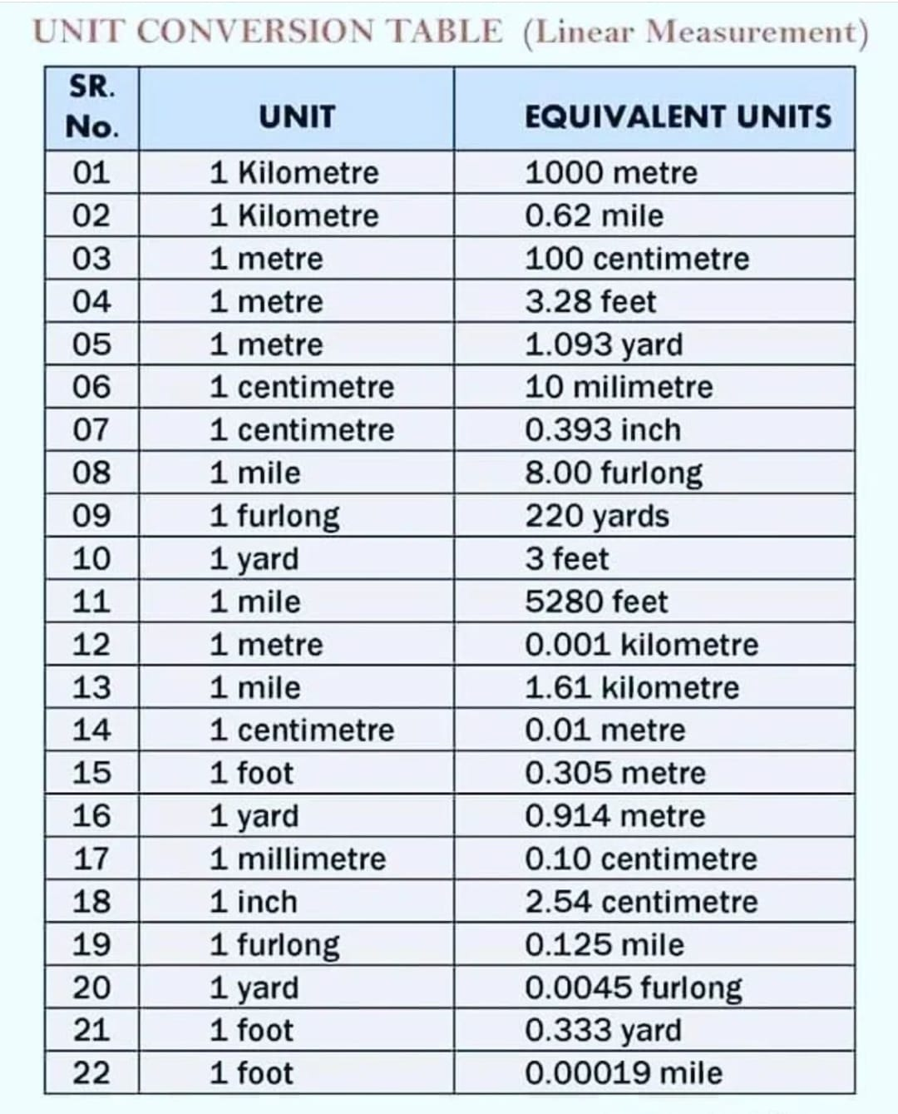
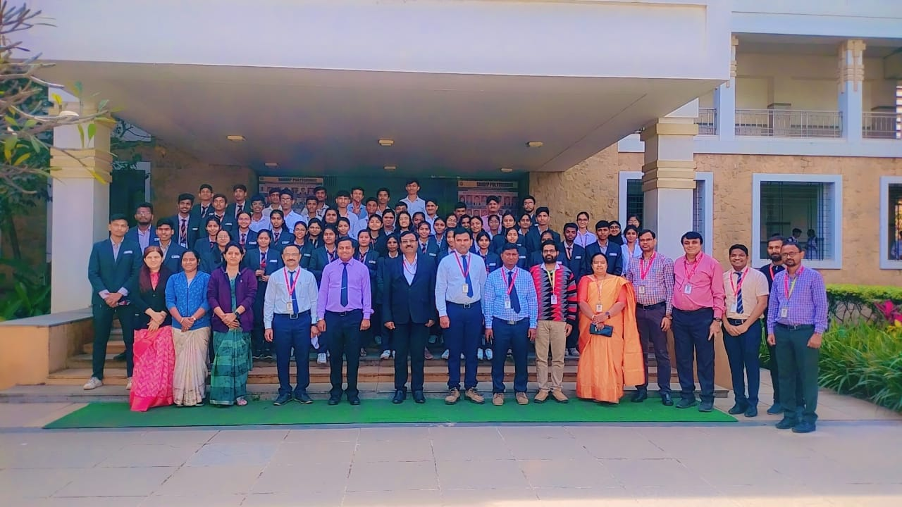
Volume 01 Issue 04
Vision and Mission of the Department
VISION:
To produce professional skilled civil engineers to face the challenges in the engineering field and pursue higher education.
MISSION:
M1:To provide quality infrastructure in the support of a conducive learning environment.
M2:To inculcate the practices towards employability, entrepreneurship and higher education.
M3:To develop a positive attitude, professional and social skills
Students corner
Poem
Photography
आज आलं पाऊस, पाऊसात ओलं आवाज. पावसाच्या डोळ्यात तोंड, मन हर्षानं भरलं आनंद. धगधग, धगधग झुर्मुर, पाऊसाच्या सागरात घुसायला उत्सुक. पाऊस सुखाचं, पाऊस आनंदाचं, घरट्यांचं हृदय सुखाचं. त्या पावसाच्या नादात, सर्वांनी गायलं गाणं. पावसाच्या तुफानात, सर्वांनी भिजलं शांतींचं. आज आलं पाऊस, सर्वांनी नाचलं हर्षानं. पावसात आनंद, पावसात उत्साह, विश्वास भरलं अशाचं.
Technical Conversion
Toppers

