Slide 1
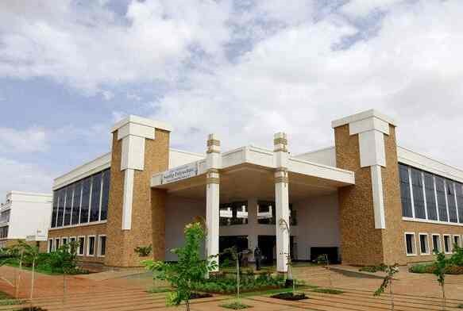
Volume 01 Issue 05
SANDIP POLYTECHNIC
March - April 2024
NEWSLETTER
Vision of Sandip Polytechnic
“To produce skilled technocrats for serving industry, Society and pursue higher education”
Mission of Sandip Polytechnic
M1 : State the art of infrastructure, qualified and competent teaching faculty.
M2 : To provide industry institute interaction, employability enhancement and higher education.
M3 : To provide platform for development professional, social skill and life long learning.
Vision and Mission of the Department
VISION:
To produce professional skilled civil engineers to face the challenges in the engineering field and pursue higher education.
MISSION:
M1: To provide quality infrastructure in the support of a conducive learning environment.
M2: To inculcate the practices towards employability, entrepreneurship and higher education.
M3: To develop a positive attitude, professional and social skills
Leading Polytechnic
College s in Nashik
When you join Sandip Polytechnic (SP) at Sandip Foundation, you are joining one of the top polytechnic colleges in Maharashtra and indeed the best polytechnic college in Nashik.
If you want to fast track your career and fast track yourself to success then there’s just one and only one place and that’s Sandip Polytechnic. Our motivation to help you become ‘insanely’ great at what you do, achieve your imagination.
Editorial Board Members
Prof. V. O. Patil
Prof. B. G. Abhale

Slide 2
Volume 01 Issue 05
Vision and Mission of the Department
VISION:
To produce professional skilled civil engineers to face the challenges in the engineering field and pursue higher education.
MISSION:
M1:To provide quality infrastructure in the support of a conducive learning environment.
M2:To inculcate the practices towards employability, entrepreneurship and higher education.
M3:To develop a positive attitude, professional and social skills
WHAT’S INSIDE
02. HOD Message
03. Editors Information
04. About Civil Department
05. Lab Information
06. Toppers
07. Expert Lecture
08. Industrial Visit
01. Chairman’s Message
09. Six days Workshop
10. State Level
Competitions

Slide 3
Volume 01 Issue 05
Vision and Mission of the Department
VISION:
To produce professional skilled civil engineers to face the challenges in the engineering field and pursue higher education.
MISSION:
M1:To provide quality infrastructure in the support of a conducive learning environment.
M2:To inculcate the practices towards employability, entrepreneurship and higher education.
M3:To develop a positive attitude, professional and social skills
Learn from your experiences for these is no greater tutor than life itself.
From Chairman’s Desk
Learn from your experience, for there is no greater tutor than life itself. I am happy to pen down a few words as prologue to our Newsletter which is exclusively meant for churning out the latent writing talent which bears immense potentiality of sharpening our students’ skills as part of their overall personality development. I congratulate all the team members and contributors of this Newsletter for bringing out such a beautiful Newsletter. Walk with those who feed your mind with motivation to further your mission. Wake up hungry for success every day; your drive for success must match the ferocity of a hungry lion attacking his prey every morning. An educated person without morals is like a room without windows. I think that morals are what ground us as a society, and without morals we would have no light to guide our educated minds. We, at Sandip Foundation, strive to make our students reliable technocrats and trustworthy citizens of India. My staunch faith and conviction is that our students would carve a niche in their career and life by going lineage and heritage through this temple of learning. I would like to take this opportunity to reiterate that there is no substitute to hard work in any venture. Therefore, it should be our endeavor to give our best in our areas of responsibilities and aim at achieving excellence for our institution. I wish all success to this venture.
HON’BLE DR. SANDIP N. JHA
Chairman, Sandip Foundation

Slide 4
Volume 01 Issue 05
Vision and Mission of the Department
VISION:
To produce professional skilled civil engineers to face the challenges in the engineering field and pursue higher education.
MISSION:
M1:To provide quality infrastructure in the support of a conducive learning environment.
M2:To inculcate the practices towards employability, entrepreneurship and higher education.
M3:To develop a positive attitude, professional and social skills
HOD Civil Engineering Department Message
From HOD’s Desk
I welcome you all to Sandip Polytechnic, the institution which has set the benchmark for quality teaching learning process. The institute strives to provide the world class faculties and facilities so that we will see you all blossom into empowered and sensitive human being. Education is the manifestation of love and my most cherished possession. It drives away the ignorance and through illumination it emboldens a man to a righteous thought and action. It energizes a society and enables a man to earn his living with respect and praise. In order to accomplish our vision and mission, we are prepared to take as much effort as possible for the betterment of academic scenario in India. Our institute cares for the individual development of each and every student. We follow the mentor system under which each class is put into multi-prolonged web of a teacher. We accord prime importance to the behavioral discipline, moral integrity and cognitive developments of our students. Our faculties strive to teach not only academic programs but also life skills needed for students.
Dr. Prof. VILAS NIKAM,
Vice Principal HODCE

Slide 5
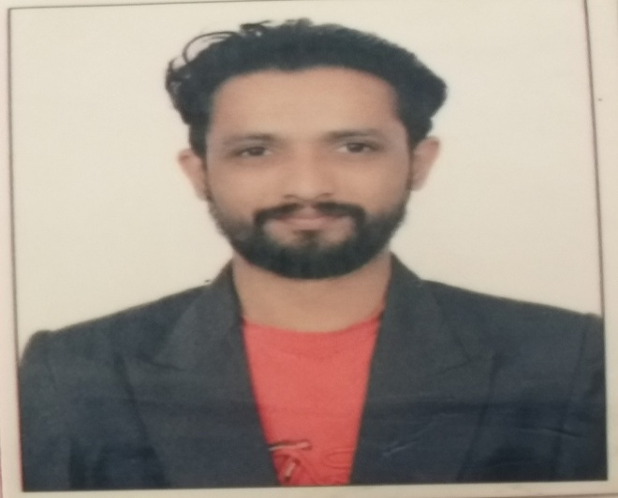
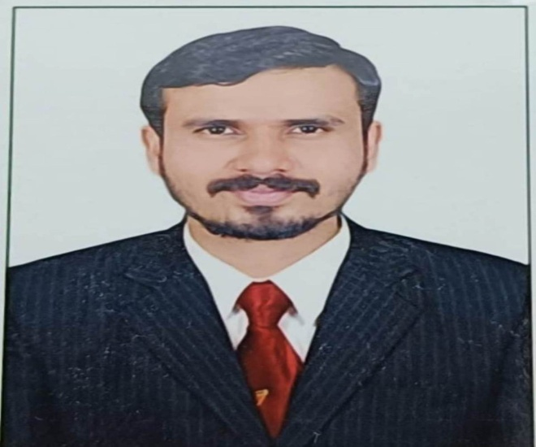
Volume 01 Issue 05
Vision and Mission of the Department
VISION:
To produce professional skilled civil engineers to face the challenges in the engineering field and pursue higher education.
MISSION:
M1:To provide quality infrastructure in the support of a conducive learning environment.
M2:To inculcate the practices towards employability, entrepreneurship and higher education.
M3:To develop a positive attitude, professional and social skills
Editors Information
Prof. V. O. Patil
ME (Structure)
vikas.patil@sandippolytechnic.org
9511940099
Prof. B. G. Abhale
ME (Environment)
bhanudas.abhale@sandippolytechnic.org
9423042624

Slide 6
Volume 01 Issue 05
Vision and Mission of the Department
VISION:
To produce professional skilled civil engineers to face the challenges in the engineering field and pursue higher education.
MISSION:
M1:To provide quality infrastructure in the support of a conducive learning environment.
M2:To inculcate the practices towards employability, entrepreneurship and higher education.
M3:To develop a positive attitude, professional and social skills
About Civil engineering department
Civil Engineering is a Professional Engineering discipline that deals with the design, construction and maintenance of the physically and naturally built environment, including works such as bridges, roads, canals, dams and buildings. Civil Engineering is the oldest Engineering Discipline after Military Engineering. It is traditionally broken into different disciplines including Environmental Engineering, Structural Engineering, Transportation Engineering, Water Resource Engineering, Geo-technical Engineering, Material Engineering, Survey Engineering and Construction Engineering. Civil Engineering takes place at all levels in the public sector and private sector.
Department Information
Programme:- Civil Engineering
Year of Establishment:- 2009
Intake Capacity:- 120
General Choice Code:- 525819110
TFWS Choice Code:- 525819111T

Slide 7
Volume 01 Issue 05
Vision and Mission of the Department
VISION:
To produce professional skilled civil engineers to face the challenges in the engineering field and pursue higher education.
MISSION:
M1:To provide quality infrastructure in the support of a conducive learning environment.
M2:To inculcate the practices towards employability, entrepreneurship and higher education.
M3:To develop a positive attitude, professional and social skills
Civil engineering LAB Details
Sr. No. | Name of Lab | Location | Cost of Lab
1 | Mechanics of Structure Lab | Ground Floor | 1082264
2 | Hydraulics Lab (Fluid Mechanics) | Ground Floor | 256497
3 | Geotechnical Engineering Lab | Ground Floor | 632350
4 | Concrete Technology Lab | Ground Floor | 845622
5 | Surveying Lab | Ground Floor | 1201804
6 | Public Health Engineering Lab | First Floor | 199615
7 | Model Lab | First Floor | 183141
8 | Engineering Mechanics Lab | First Floor | 314878
9 | Highway Engineering Lab | First Floor | 108821
10 | CAD Lab | First Floor | --

Slide 8
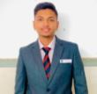
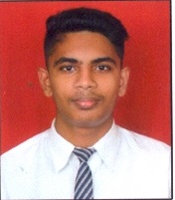
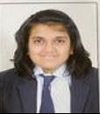
Volume 01 Issue 05
Vision and Mission of the Department
VISION:
To produce professional skilled civil engineers to face the challenges in the engineering field and pursue higher education.
MISSION:
M1:To provide quality infrastructure in the support of a conducive learning environment.
M2:To inculcate the practices towards employability, entrepreneurship and higher education.
M3:To develop a positive attitude, professional and social skills
Civil engineering Toppers SYCE W-23
Sr. No | Name of Student | Enrolment No | Class | % | Photos
1 | GAIKWAD OMKAR SANTOSH | 2111670120 | TYCE | 91.10
2 | DANDGAVAL POOJA MANOJ | 2111670119 | TYCE | 89.80
3 | PHADOL ADITYA DATTATRAY | 2111670060 | TYCE | 88.30

Slide 9
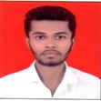
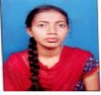
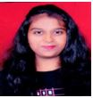
Volume 01 Issue 05
Vision and Mission of the Department
VISION:
To produce professional skilled civil engineers to face the challenges in the engineering field and pursue higher education.
MISSION:
M1:To provide quality infrastructure in the support of a conducive learning environment.
M2:To inculcate the practices towards employability, entrepreneurship and higher education.
M3:To develop a positive attitude, professional and social skills
Civil engineering Toppers TYCE W-23
Sr. No | Name of Student | Enrolment No | Class | % | Photos
01 | PRATHAMESH SHRAVAN DHANRALE | 2211670075 | SYCE | 87.89
02 | JAGTAP ISHA SANJAY | 2211670010 | SYCE | 86.32
03 | CHAROSKAR PAYAL SHARAD | 2211670008 | SYCE | 82.11

Slide 10
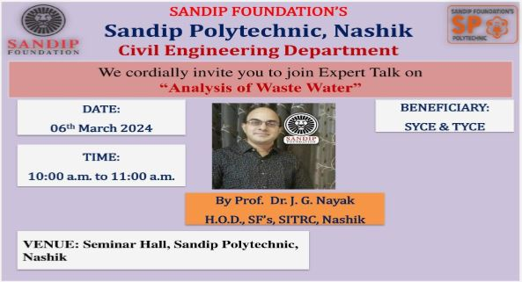
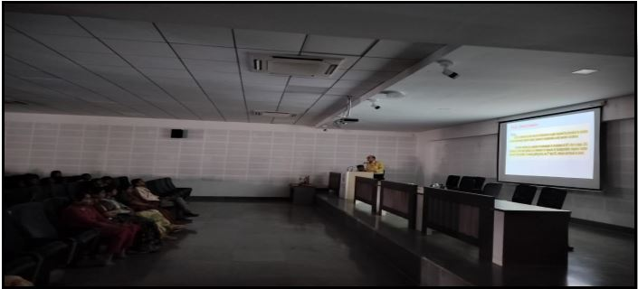
Volume 01 Issue 05
Vision and Mission of the Department
VISION:
To produce professional skilled civil engineers to face the challenges in the engineering field and pursue higher education.
MISSION:
M1:To provide quality infrastructure in the support of a conducive learning environment.
M2:To inculcate the practices towards employability, entrepreneurship and higher education.
M3:To develop a positive attitude, professional and social skills
Expert Lectures
Expert lecture on Analysis of Waste Water
Name of Event:
Expert lecture on Analysis of Waste Water.
Date of Expert Lecture:-
06.03.2024
Resource Person:-
Prof. Dr. J. G. Naik
Participants:-
SYCE & TYCE Students
Objectives:-
Analyzing wastewater helps in assessing the levels of various pollutants present in the water. This includes organic matter, nutrients (nitrogen and phosphorus), heavy metals, pathogens, and other contaminants.
Wastewater analysis is essential for monitoring compliance with regulatory standards and permits.

Slide 11
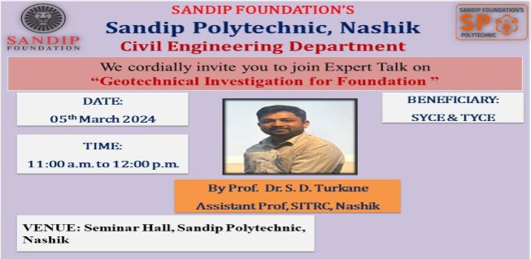
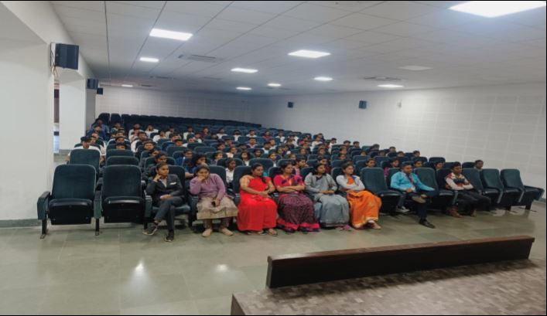
Volume 01 Issue 05
Vision and Mission of the Department
VISION:
To produce professional skilled civil engineers to face the challenges in the engineering field and pursue higher education.
MISSION:
M1:To provide quality infrastructure in the support of a conducive learning environment.
M2:To inculcate the practices towards employability, entrepreneurship and higher education.
M3:To develop a positive attitude, professional and social skills
Expert Lectures
Expert Lecture on Geotechnical Investigation for Foundation
Name of Event:
Expert Lecture on Geotechnical Investigation for foundation.
Date of Expert Lecture:-
05.03.2024
Resource Person:-
Prof. S. D. Turakane
Participants:-
SYCE & TYCE Students
Objectives:-
These investigations help understand the geological and geotechnical properties of the site.
These investigations also assess groundwater conditions, including depth, flow, and potential effects on foundation stability.
Ultimately, the data collected from geotechnical investigations is used to design appropriate foundations that can safely support the intended structure while considering factors like soil bearing capacity, settlement, and groundwater conditions.

Slide 12
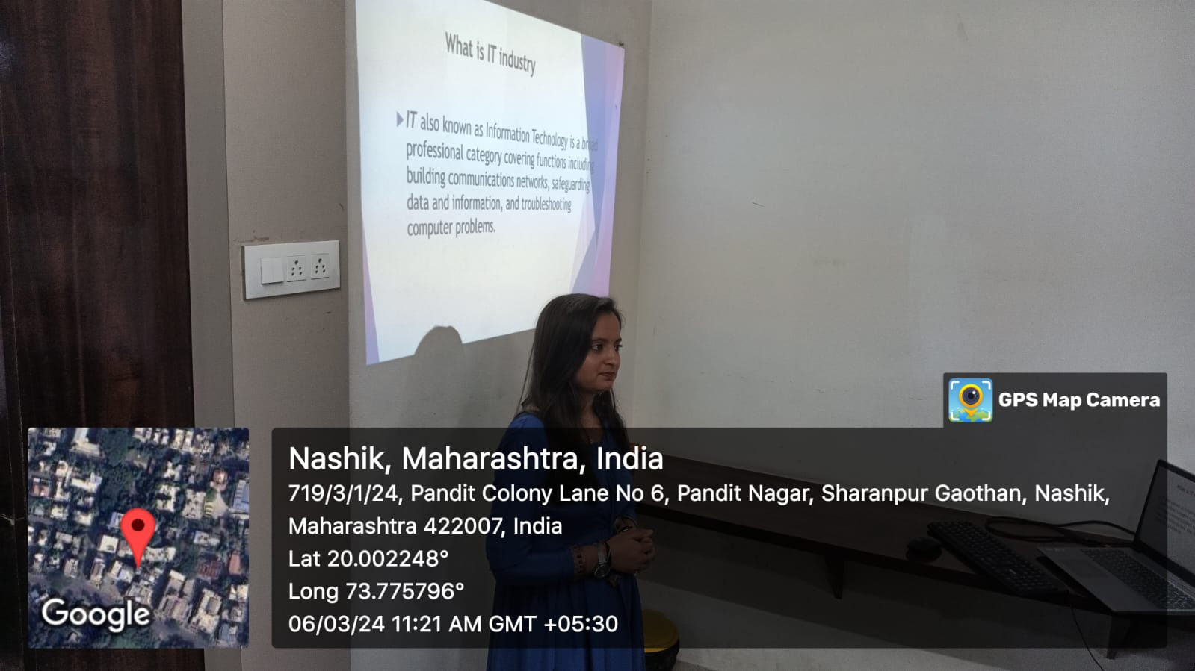
Volume 01 Issue 05
Vision and Mission of the Department
VISION:
To produce professional skilled civil engineers to face the challenges in the engineering field and pursue higher education.
MISSION:
M1:To provide quality infrastructure in the support of a conducive learning environment.
M2:To inculcate the practices towards employability, entrepreneurship and higher education.
M3:To develop a positive attitude, professional and social skills
Expert Lectures
Expert Lecture on Financial Literacy
Name of Event:
Expert Lecture on Financial Literacy.
Date of Expert Lecture:-
06.03.2024
Resource Person:-
Mrs. D. V. Kale
Participants:-
SYCE & TYCE Students and Faculty Members
Objectives:-
The lecture should aim to provide participants with a clear understanding of fundamental financial concepts such as budgeting, saving, investing, debt management, and financial planning.
The lecture should help participants develop critical thinking and decision-making skills related to financial matters.

Slide 13
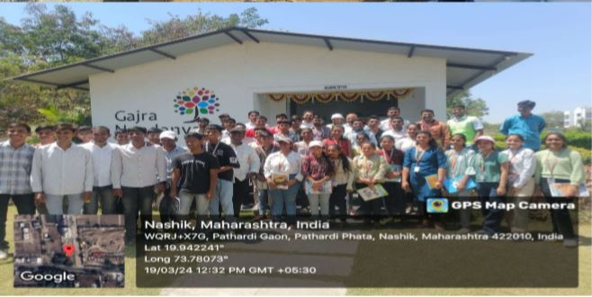
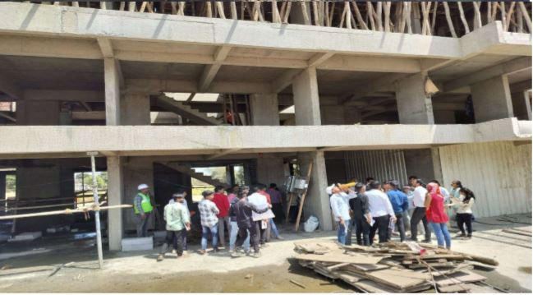
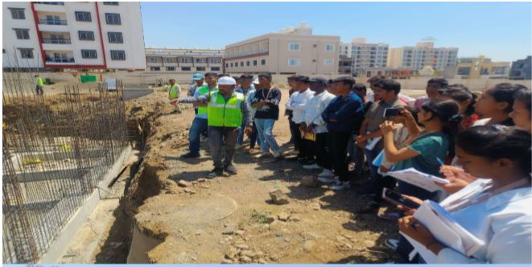
Volume 01 Issue 05
Vision and Mission of the Department
VISION:
To produce professional skilled civil engineers to face the challenges in the engineering field and pursue higher education.
MISSION:
M1:To provide quality infrastructure in the support of a conducive learning environment.
M2:To inculcate the practices towards employability, entrepreneurship and higher education.
M3:To develop a positive attitude, professional and social skills
Industrial Visits
Sub Structure and Super Structure visit at Gajra Associates
Name of Event:
Visit under Building Material Construction subject to know Components of Sub structure & Super Structure at Gajra Associates.
Date of Visit:-
19.03.2024
Visit Location:-
Sandip Foundation Campus, Near Olive Canteen, Nashik.
Participants:-
SYCE & TYCE Students
Objectives:-
Identify components of substructure and Super-structure of building.
Propose suitable type of foundation of building structures.
To Understand the finishing Work of building.

Slide 14
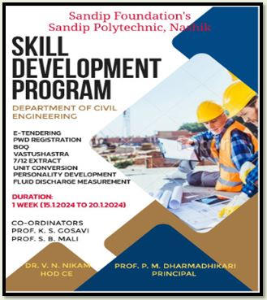
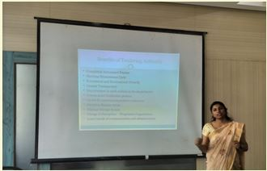
Volume 01 Issue 05
Vision and Mission of the Department
VISION:
To produce professional skilled civil engineers to face the challenges in the engineering field and pursue higher education.
MISSION:
M1:To provide quality infrastructure in the support of a conducive learning environment.
M2:To inculcate the practices towards employability, entrepreneurship and higher education.
M3:To develop a positive attitude, professional and social skills
Six day’s Workshop on on
E-Tendering
Six day’s Workshop on E-Tendering
Name of Event:
Six day’s Workshop on E-Tendering. .
Date of Expert Lecture:-
15.01.2024
Location:-
Sandip Polytechnic Building Class Room 203.
Participants:-
TYCE Students
Objectives:-
The main objective of the workshop is to know the importance & Procedure of E- Tendering in Construction Industry.
Importance of registration in PWD/WRD/ZP.
Importance of BOQ.
Importance of Quotation which is in Percentage Above OR Below.

Slide 15
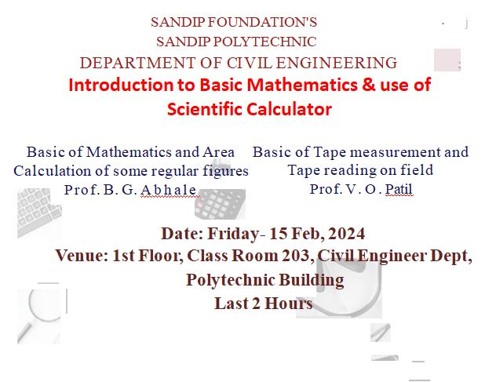
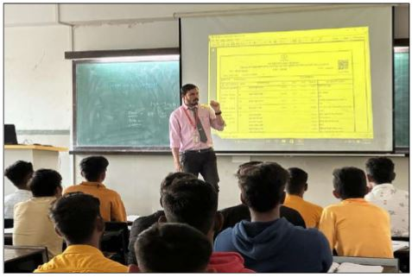
Volume 01 Issue 05
Vision and Mission of the Department
VISION:
To produce professional skilled civil engineers to face the challenges in the engineering field and pursue higher education.
MISSION:
M1:To provide quality infrastructure in the support of a conducive learning environment.
M2:To inculcate the practices towards employability, entrepreneurship and higher education.
M3:To develop a positive attitude, professional and social skills
Skill Development
Introduction to Basic Mathematics & use of Scientific Calculator
Name of Event:
Introduction to Basic Mathematics & use of Scientific Calculator. .
Date of Expert Lecture:-
Feb. 2024
Location:-
Sandip Polytechnic Building Class Room 204.
Participants:-
SYCE Students
Objectives:-
The main objective of the workshop is to know the importance & Procedure of E- Tendering in Construction Industry.
Importance of registration in PWD/WRD/ZP.

Slide 16
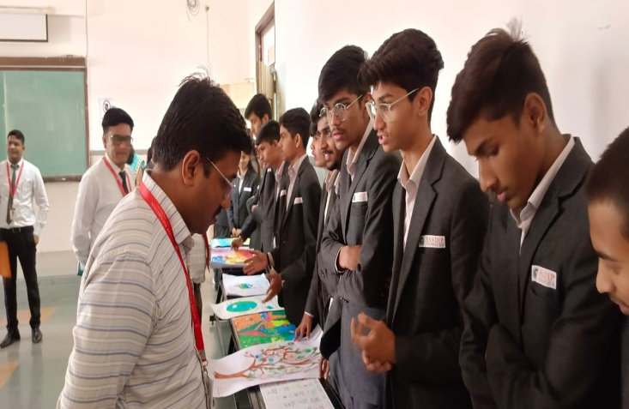
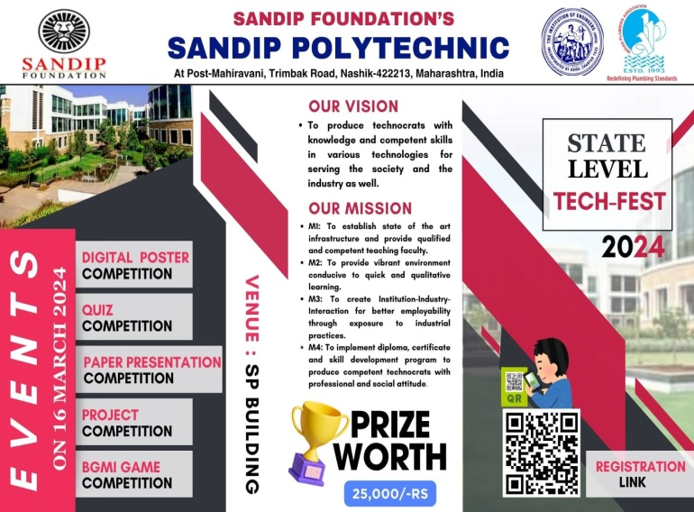
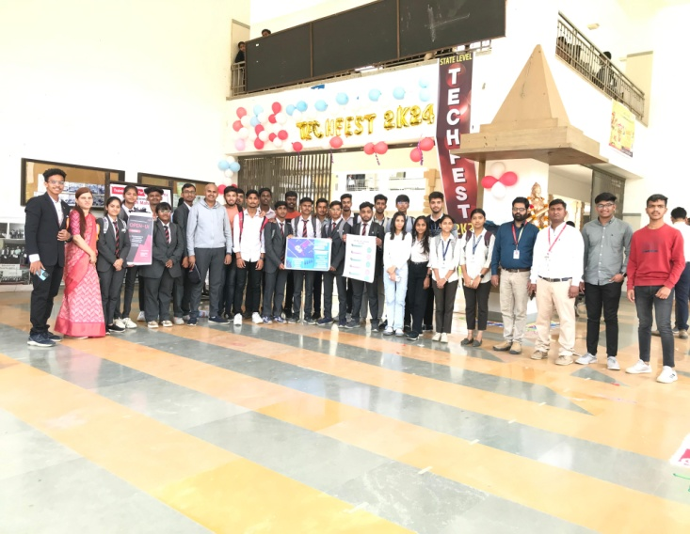
Volume 01 Issue 05
Vision and Mission of the Department
VISION:
To produce professional skilled civil engineers to face the challenges in the engineering field and pursue higher education.
MISSION:
M1:To provide quality infrastructure in the support of a conducive learning environment.
M2:To inculcate the practices towards employability, entrepreneurship and higher education.
M3:To develop a positive attitude, professional and social skills
State level Competition
Poster Making Competition
Name of Event:
Poster Making Competition. .
Date of Expert Lecture:-
16.03.2024
Location:-
Sandip Polytechnic Building Drawing Hall.
Participants:-
TYCE & SYCE Students
Objectives:-
Poster competitions can serve as educational tools, especially in schools and universities. They provide opportunities for students to research topics, learn about different art techniques, and develop their artistic skills in a fun and interactive way.
Poster-making competitions serve as a platform for personal growth, community engagement, and positive social impact.

Slide 17
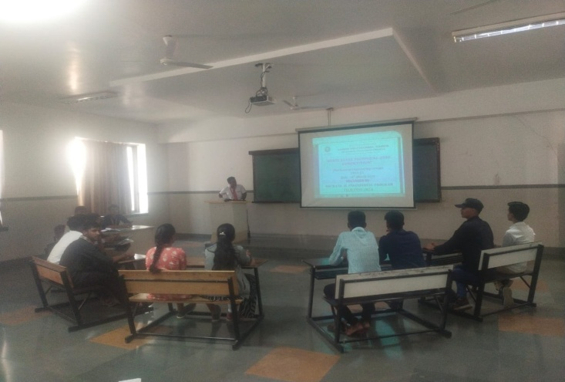
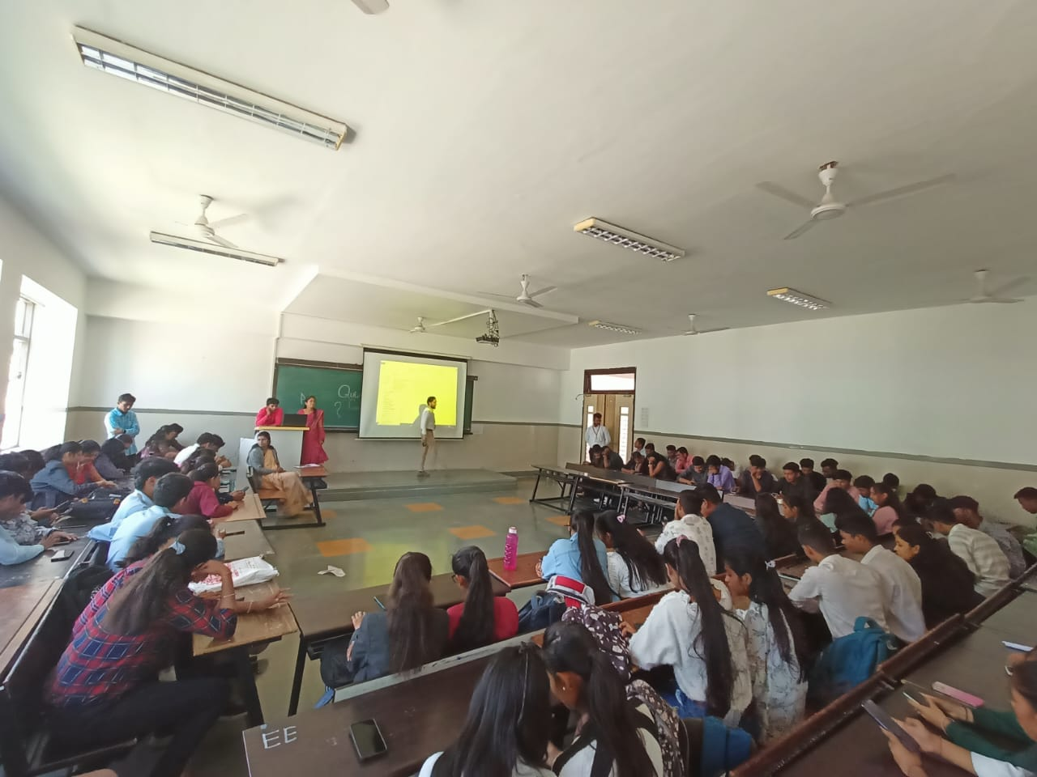
Volume 01 Issue 05
Vision and Mission of the Department
VISION:
To produce professional skilled civil engineers to face the challenges in the engineering field and pursue higher education.
MISSION:
M1:To provide quality infrastructure in the support of a conducive learning environment.
M2:To inculcate the practices towards employability, entrepreneurship and higher education.
M3:To develop a positive attitude, professional and social skills
State level Competition
Quiz Competition
Name of Event:
Quiz Competition. .
Date of Expert Lecture:-
16.03.2023
Location:-
Sandip Polytechnic Class room 203.
Participants:-
TYCE & SYCE Students
Objectives:-
The primary objective of quiz competitions is to encourage participants to acquire knowledge across different subjects or themes.
Quiz questions often require participants to analyze information, make connections, and apply reasoning skills to arrive at answers. This process fosters critical thinking abilities, helping participants become better problem solvers.
Engaging in quiz competitions can enhance participants' ability to retain information and recall it when needed.

Slide 18
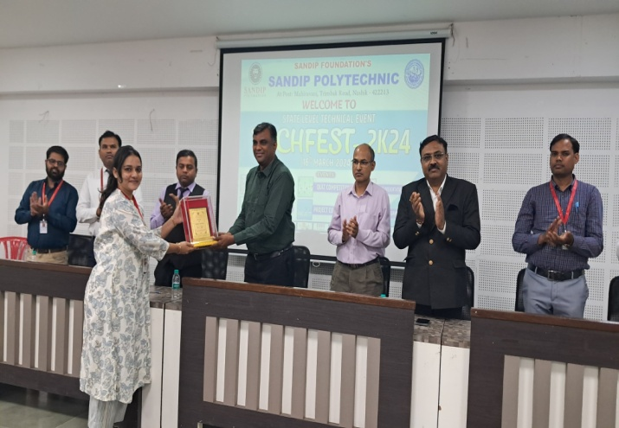
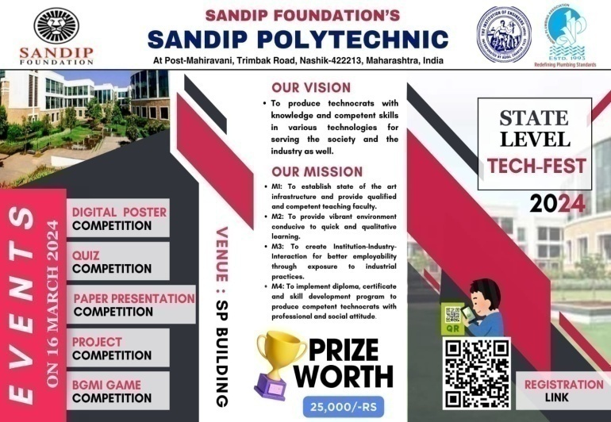
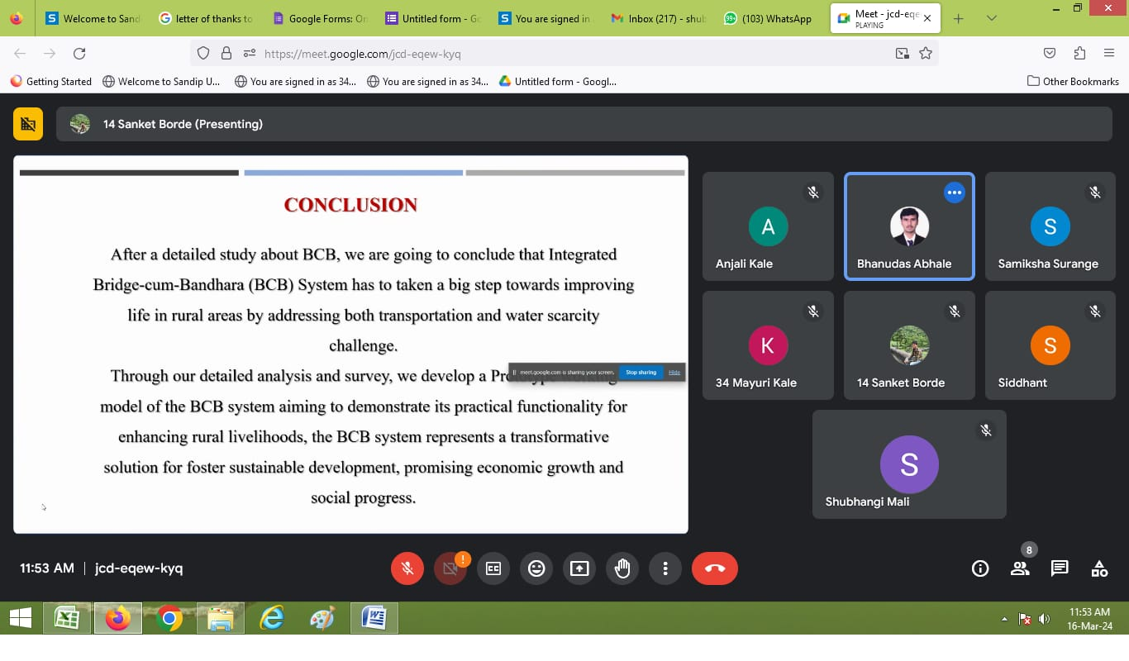
Volume 01 Issue 05
Vision and Mission of the Department
VISION:
To produce professional skilled civil engineers to face the challenges in the engineering field and pursue higher education.
MISSION:
M1:To provide quality infrastructure in the support of a conducive learning environment.
M2:To inculcate the practices towards employability, entrepreneurship and higher education.
M3:To develop a positive attitude, professional and social skills
State level Competition
Paper Presentation Competition
Name of Event:
Paper Presentation Competition. .
Date of Expert Lecture:-
16.03.2024
Location:-
Sandip Polytechnic Class room 204.
Participants:-
TYCE & SYCE Students
Objectives:-
Encouraging participants to conduct original research and contribute to the advancement of knowledge in their field.
Providing a platform for participants to improve their communication and presentation skills by effectively conveying complex ideas in a clear and engaging manner.
Creating opportunities for participants to interact with peers, experts, and industry professionals, fostering collaboration and networking within the academic and professional community.

Slide 19
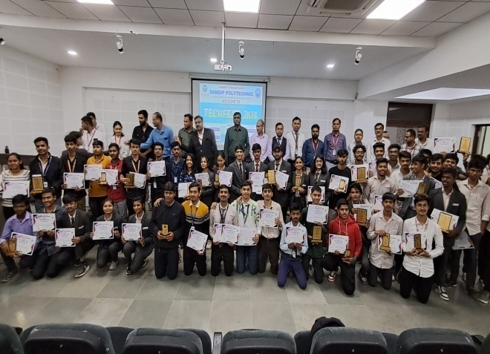

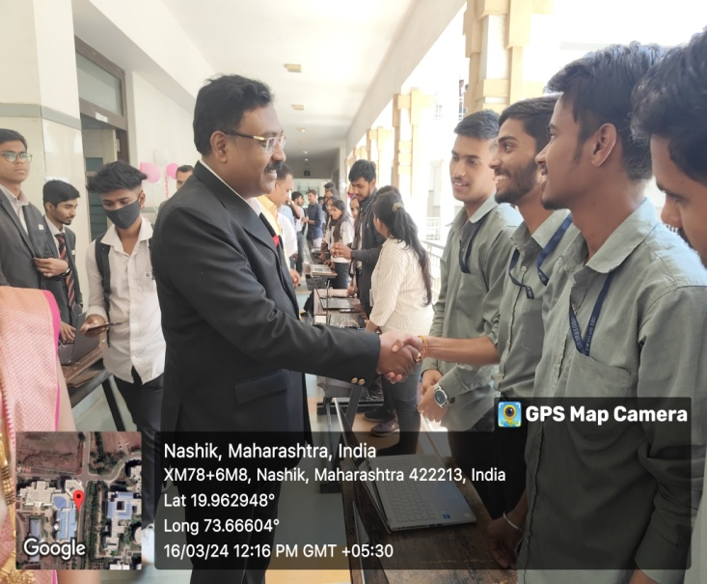
Volume 01 Issue 05
Vision and Mission of the Department
VISION:
To produce professional skilled civil engineers to face the challenges in the engineering field and pursue higher education.
MISSION:
M1:To provide quality infrastructure in the support of a conducive learning environment.
M2:To inculcate the practices towards employability, entrepreneurship and higher education.
M3:To develop a positive attitude, professional and social skills
State level Competition
Project Competition
Name of Event:
State level Project Competition. .
Date of Expert Lecture:-
16.03.2024
Location:-
Sandip Polytechnic Class room 101.
Participants:-
TYCE & SYCE Students
Objectives:-
Presentation skill and stage daring will be improved.
Improvement in their ideas and thoughts.

