Slide 1

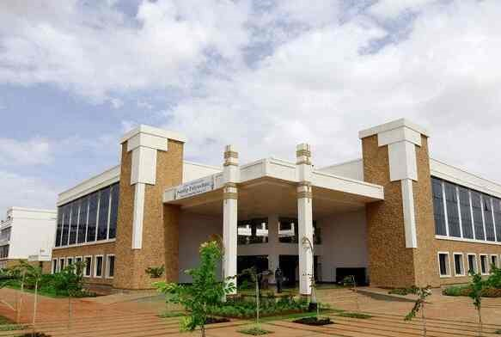
Volume 01 Issue 03
SANDIP
POLYTECHNIC
August - December 2022
NEWSLETTER
Vision of Sandip Polytechnic
“To produce skilled technocrats for serving industry, Society and pursue higher education”
Mission of Sandip Polytechnic
M1 : State the art of infrastructure, qualified and competent teaching faculty.
M2: To provide industry institute interaction, employability enhancement and higher education.
M3: To provide platform for development professional, social skill and life long learning.
Vision and Mission of the Department
VISION:
To produce professional skilled civil engineers to face the challenges in the engineering field and pursue higher education.
MISSION:
M1: To provide quality infrastructure in the support of a conducive learning environment.
M2: To inculcate the practices towards employability, entrepreneurship and higher education.
M3: To develop a positive attitude, professional and social skills
Leading Polytechnic
College s in Nashik
When you join Sandip Polytechnic (SP) at Sandip Foundation, you are joining one of the top polytechnic colleges in Maharashtra and indeed the best polytechnic college in Nashik.
If you want to fast track your career and fast track yourself to success then there’s just one and only one place and that’s Sandip Polytechnic. Our motivation to help you become ‘insanely’ great at what you do, achieve your imagination.
Editorial Board Members
Prof. V. O. Patil
Prof. B. G. Abhale

Slide 2

Volume 01 Issue 03
Vision and Mission of the Department
VISION:
To produce professional skilled civil engineers to face the challenges in the engineering field and pursue higher education.
MISSION:
M1:To provide quality infrastructure in the support of a conducive learning environment.
M2:To inculcate the practices towards employability, entrepreneurship and higher education.
M3:To develop a positive attitude, professional and social skills
WHAT’S INSIDE
02. HOD Massage
03. Editors Information
04. About Civil Department
05. Lab Information
06. Toppers
07. Industrial Visits
08. Personality Development Lecture
09. Skill Development Event
01. Chairman’s Message
10. Competition
11. One Day Workshop
12. Students Corner

Slide 3
Volume 01 Issue 03
Vision and Mission of the Department
VISION:
To produce professional skilled civil engineers to face the challenges in the engineering field and pursue higher education.
MISSION:
M1:To provide quality infrastructure in the support of a conducive learning environment.
M2:To inculcate the practices towards employability, entrepreneurship and higher education.
M3:To develop a positive attitude, professional and social skills
Learn from your experiences for these is no greater tutor than life itself.
From Chairman’s Desk
Learn from your experience, for there is no greater tutor than life itself. I am happy to pen down a few words as prologue to our Newsletter which is exclusively meant for churning out the latent writing talent which bears immense potentiality of sharpening our students’ skills as part of their overall personality development. I congratulate all the team members and contributors of this Newsletter for bringing out such a beautiful Newsletter. Walk with those who feed your mind with motivation to further your mission. Wake up hungry for success every day; your drive for success must match the ferocity of a hungry lion attacking his prey every morning. An educated person without morals is like a room without windows. I think that morals are what ground us as a society, and without morals we would have no light to guide our educated minds. We, at Sandip Foundation, strive to make our students reliable technocrats and trustworthy citizens of India. My staunch faith and conviction is that our students would carve a niche in their career and life by going lineage and heritage through this temple of learning. I would like to take this opportunity to reiterate that there is no substitute to hard work in any venture. Therefore, it should be our endeavor to give our best in our areas of responsibilities and aim at achieving excellence for our institution. I wish all success to this venture.
HON’BLE DR. SANDIP N. JHA
Chairman, Sandip Foundation

Slide 4

Volume 01 Issue 03
Vision and Mission of the Department
VISION:
To produce professional skilled civil engineers to face the challenges in the engineering field and pursue higher education.
MISSION:
M1:To provide quality infrastructure in the support of a conducive learning environment.
M2:To inculcate the practices towards employability, entrepreneurship and higher education.
M3:To develop a positive attitude, professional and social skills
HOD Civil Engineering Department Massage
From HOD’s Desk
I welcome you all to Sandip Polytechnic, the institution which has set the benchmark for quality teaching learning process. The institute strives to provide the world class faculties and facilities so that we will see you all blossom into empowered and sensitive human being. Education is the manifestation of love and my most cherished possession. It drives away the ignorance and through illumination it emboldens a man to a righteous thought and action. It energizes a society and enables a man to earn his living with respect and praise. In order to accomplish our vision and mission, we are prepared to take as much effort as possible for the betterment of academic scenario in India. Our institute cares for the individual development of each and every student. We follow the mentor system under which each class is put into multi-prolonged web of a teacher. We accord prime importance to the behavioral discipline, moral integrity and cognitive developments of our students. Our faculties strive to teach not only academic programs but also life skills needed for students.
Dr. Prof. VILAS NIKAM,
Vice Principal HODCE

Slide 5
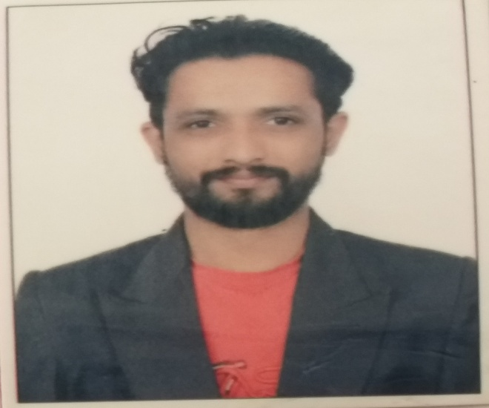
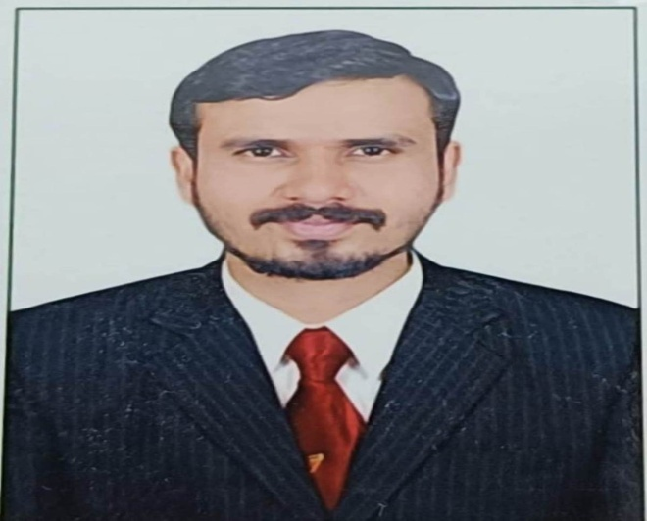
Volume 01 Issue 03
Vision and Mission of the Department
VISION:
To produce professional skilled civil engineers to face the challenges in the engineering field and pursue higher education.
MISSION:
M1:To provide quality infrastructure in the support of a conducive learning environment.
M2:To inculcate the practices towards employability, entrepreneurship and higher education.
M3:To develop a positive attitude, professional and social skills
Editors Information
Prof. V. O. Patil
ME (Structure)
vikas.patil@sandippolytechnic.org
9511940099
Prof. B. G. Abhale
ME (Environment)
bhanudas.abhale@sandippolytechnic.org
9423042624

Slide 6
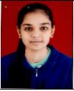
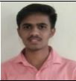
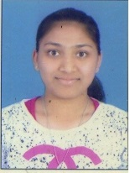
Volume 01 Issue 03
Vision and Mission of the Department
VISION:
To produce professional skilled civil engineers to face the challenges in the engineering field and pursue higher education.
MISSION:
M1:To provide quality infrastructure in the support of a conducive learning environment.
M2:To inculcate the practices towards employability, entrepreneurship and higher education.
M3:To develop a positive attitude, professional and social skills
Students Details FY-SY-TY
SAKSHI SHARAD SHINDE
HARSHAD SURYAWANSHI KEDA
NANDINI ASHOK GANGURDE

Slide 7
Volume 01 Issue 03
Vision and Mission of the Department
VISION:
To produce professional skilled civil engineers to face the challenges in the engineering field and pursue higher education.
MISSION:
M1:To provide quality infrastructure in the support of a conducive learning environment.
M2:To inculcate the practices towards employability, entrepreneurship and higher education.
M3:To develop a positive attitude, professional and social skills
About Civil engineering department
Civil Engineering is a Professional Engineering discipline that deals with the design, construction and maintenance of the physically and naturally built environment, including works such as bridges, roads, canals, dams and buildings. Civil Engineering is the oldest Engineering Discipline after Military Engineering. It is traditionally broken into different disciplines including Environmental Engineering, Structural Engineering, Transportation Engineering, Water Resource Engineering, Geo-technical Engineering, Material Engineering, Survey Engineering and Construction Engineering. Civil Engineering takes place at all levels in the public sector and private sector.
Department Information
Programme:- Civil Engineering
Year of Establishment:- 2009
Intake Capacity:- 120
General Choice Code:- 525819110
TFWS Choice Code:- 525819111T

Slide 8
Volume 01 Issue 03
Vision and Mission of the Department
VISION:
To produce professional skilled civil engineers to face the challenges in the engineering field and pursue higher education.
MISSION:
M1:To provide quality infrastructure in the support of a conducive learning environment.
M2:To inculcate the practices towards employability, entrepreneurship and higher education.
M3:To develop a positive attitude, professional and social skills
Civil engineering LAB Details
Sr. No. | Name of Lab | Location | Cost of Lab
1 | Mechanics of Structure Lab | Ground Floor | 1082264
2 | Hydraulics Lab (Fluid Mechanics) | Ground Floor | 256497
3 | Geotechnical Engineering Lab | Ground Floor | 632350
4 | Concrete Technology Lab | Ground Floor | 845622
5 | Surveying Lab | Ground Floor | 1201804
6 | Public Health Engineering Lab | First Floor | 199615
7 | Model Lab | First Floor | 183141
8 | Engineering Mechanics Lab | First Floor | 314878
9 | Highway Engineering Lab | First Floor | 108821
10 | CAD Lab | First Floor | --

Slide 9
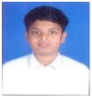
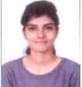
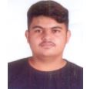
Volume 01 Issue 03
Vision and Mission of the Department
VISION:
To produce professional skilled civil engineers to face the challenges in the engineering field and pursue higher education.
MISSION:
M1:To provide quality infrastructure in the support of a conducive learning environment.
M2:To inculcate the practices towards employability, entrepreneurship and higher education.
M3:To develop a positive attitude, professional and social skills
Civil engineering Toppers TYCE S-22
Sr. No. | Name of Student | Enrolment No | Class | % | Photos
01 | SONAR SOHAM SUNIL | 1911670265 | TYCE | 90.44
02 | BHANUSHALI KEYUR SURESHBHAI | 1911670263 | TYCE | 88.00
03 | MANASI MUKESH PATHAK | 1911670284 | TYCE | 85.00

Slide 10
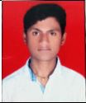
Volume 01 Issue 03
Vision and Mission of the Department
VISION:
To produce professional skilled civil engineers to face the challenges in the engineering field and pursue higher education.
MISSION:
M1:To provide quality infrastructure in the support of a conducive learning environment.
M2:To inculcate the practices towards employability, entrepreneurship and higher education.
M3:To develop a positive attitude, professional and social skills
Civil engineering Toppers SYCE s-22
Sr. No | Name of Student | Enrolment No | Class | % | Photos
1 | SURYAWANSHI HARSHAD KEDA | 2011670266 | SYCE | 76.88
2 | SAKSHI SHARAD SHINDE | 2111670494 | SYCE | 75.75
3 | YADAV AJAY BIJAYNARAYAN | 2111670492 | SYCE | 75.00

Slide 11
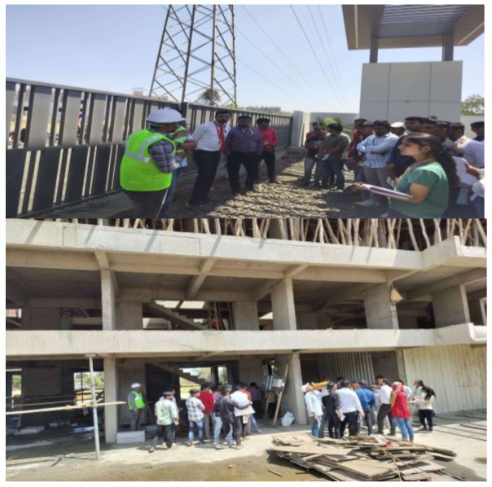
Volume 01 Issue 03
Vision and Mission of the Department
VISION:
To produce professional skilled civil engineers to face the challenges in the engineering field and pursue higher education.
MISSION:
M1:To provide quality infrastructure in the support of a conducive learning environment.
M2:To inculcate the practices towards employability, entrepreneurship and higher education.
M3:To develop a positive attitude, professional and social skills
Industrial Visits
Industrial Visit to Superstructure in Building Construction
Name of Event:
Industrial visit to Superstructure in Building Construction.
Date of Visit:-
14.11.2022
Visit Location:-
Fadol Mala Mauli Lawns Nashik
Participants:-
SYCE Students
Objectives:-
1. Verify that the construction of the superstructure meets the approved plans and specifications.
2. Evaluate the quality of workmanship and construction practices used in building the superstructure. This involves inspecting the finishes, joints, connections, and other details for defects, inconsistencies, or deviations from the approved plans.
3. Understand different super structural components parts of building .

Slide 12
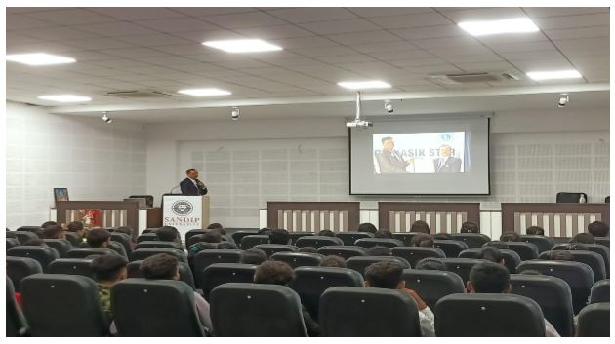
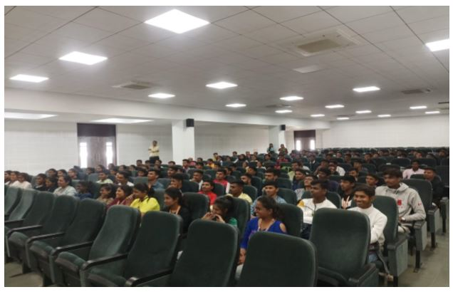
Volume 01 Issue 03
Vision and Mission of the Department
VISION:
To produce professional skilled civil engineers to face the challenges in the engineering field and pursue higher education.
MISSION:
M1:To provide quality infrastructure in the support of a conducive learning environment.
M2:To inculcate the practices towards employability, entrepreneurship and higher education.
M3:To develop a positive attitude, professional and social skills
Expert Lectures
Personality Development: The Art of Success
Name of Event:
Personality Development: The Art of Success.
Date of Expert Lecture:-
03.10.2022
Resource Person:-
Mr. Kiran Mohite
Participants:-
SYCE & TYCE Students
Objectives:-
Help individuals gain a deeper understanding of themselves, their strengths, weaknesses, values, beliefs, and motivations.
Build confidence and self-esteem by providing strategies for overcoming self-doubt, negative self-talk, and limiting beliefs.
Enhance verbal and non-verbal communication skills, including active listening, assertiveness, clarity, and empathy.

Slide 13
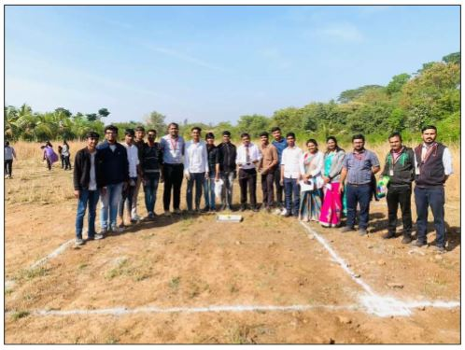
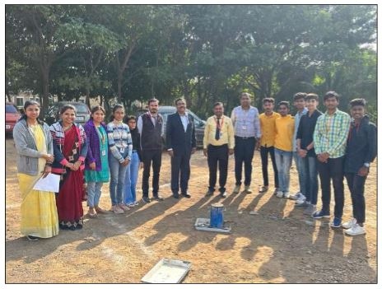
Volume 01 Issue 03
Vision and Mission of the Department
VISION:
To produce professional skilled civil engineers to face the challenges in the engineering field and pursue higher education.
MISSION:
M1:To provide quality infrastructure in the support of a conducive learning environment.
M2:To inculcate the practices towards employability, entrepreneurship and higher education.
M3:To develop a positive attitude, professional and social skills
Skill development 2022
Foundation Layout
Testing of Civil Engineering material
Name of Event:
Foundation Layout.
Date of Expert Lecture:-
22.11.2022
Location:-
Sandip Polytechnic Parking ground.
Participants:-
SYCE & TYCE Students
Objectives:-
This competition is organized to develop structural skill among the students..
Students should able to understand the how to implement layout by using Drawing.
Name of Event:
Testing of Civil Engineering material.
Date of Expert Lecture:-
23.11.2022
Location:-
Sandip Polytechnic Parking ground.
Participants:-
SYCE & TYCE Students
Objectives:-
To understand the procedure of material testing.
To understand the equipment used for lab test and field test of material.
To understand the acceptance criteria for use of materials.

Slide 14
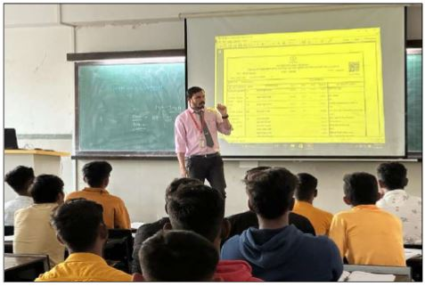
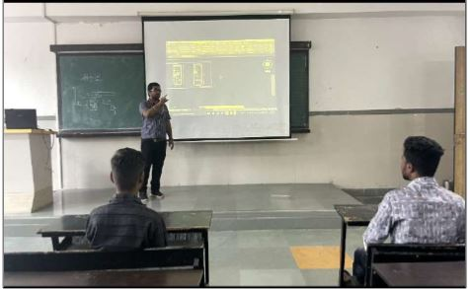
Volume 01 Issue 03
Vision and Mission of the Department
VISION:
To produce professional skilled civil engineers to face the challenges in the engineering field and pursue higher education.
MISSION:
M1:To provide quality infrastructure in the support of a conducive learning environment.
M2:To inculcate the practices towards employability, entrepreneurship and higher education.
M3:To develop a positive attitude, professional and social skills
Skill development 2022
Introduction to Auto-CAD and basic settings & Commands to be used
Quantity calculation using Spread sheet & CAD
Name of Event:
Introduction to Auto-CAD and basic settings & Commands to be used.
Date of Expert Lecture:-
26.11.2022
Location:-
Class Room 203 Sandip Polytechnic.
Participants:-
SYCE & TYCE Students
Objectives:-
Speed in drafting of civil engineering drawings.
Printing of drawings on different size of sheets.
Name of Event:
Quantity calculation using Spread sheet & CAD.
Date of Expert Lecture:-
24.11.2022
Location:-
Class Room 203 Sandip Polytechnic.
Participants:-
SYCE & TYCE Students
Objectives:-
Effective use of soft computing technique.
To determine the estimated cost of proposed work.

Slide 15
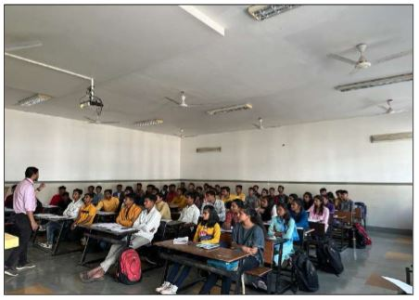
Volume 01 Issue 03
Vision and Mission of the Department
VISION:
To produce professional skilled civil engineers to face the challenges in the engineering field and pursue higher education.
MISSION:
M1:To provide quality infrastructure in the support of a conducive learning environment.
M2:To inculcate the practices towards employability, entrepreneurship and higher education.
M3:To develop a positive attitude, professional and social skills
Skill development 2022
Introduction to Basic Mathematics & use of Scientific Calculator
Name of Event:
Introduction to Basic Mathematics & use of Scientific Calculator.
Date of Expert Lecture:-
21.11.2022
Location:-
Class Room 203 Sandip Polytechnic.
Participants:-
SYCE & TYCE Students
Objectives:-
Effective use of basic mathematics and scientific calculator.
Minimise the error while using calculator.

Slide 16
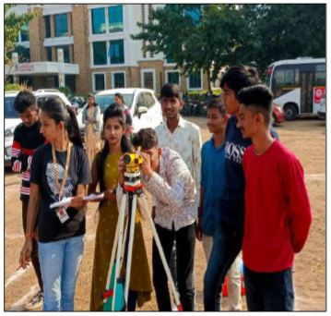
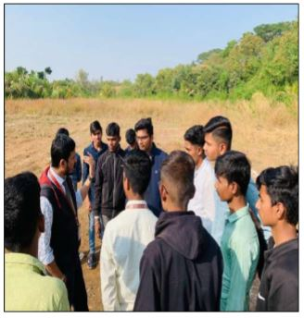
Volume 01 Issue 03
Vision and Mission of the Department
VISION:
To produce professional skilled civil engineers to face the challenges in the engineering field and pursue higher education.
MISSION:
M1:To provide quality infrastructure in the support of a conducive learning environment.
M2:To inculcate the practices towards employability, entrepreneurship and higher education.
M3:To develop a positive attitude, professional and social skills
Skill development 2022
Use of Auto Level for Ground Elevation calculations
Name of Event:
Use of Auto Level for Ground Elevation calculations.
Date of Expert Lecture:-
25.11.2022
Location:-
Sandip Polytechnic Parking ground.
Participants:-
SYCE & TYCE Students
Objectives:-
Ground elevation calculation.
Effective use of Auto-Level.

Slide 17
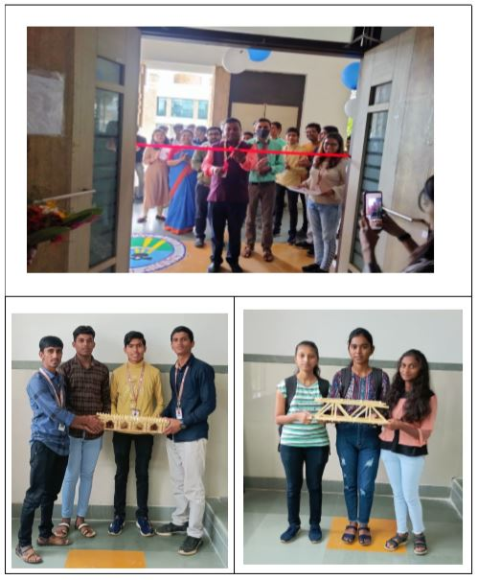
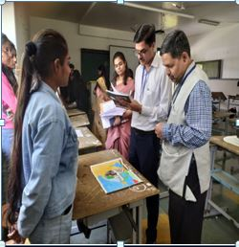
Volume 01 Issue 03
Vision and Mission of the Department
VISION:
To produce professional skilled civil engineers to face the challenges in the engineering field and pursue higher education.
MISSION:
M1:To provide quality infrastructure in the support of a conducive learning environment.
M2:To inculcate the practices towards employability, entrepreneurship and higher education.
M3:To develop a positive attitude, professional and social skills
Competition
Bridge Making Competiton
Poster Making Competition
Name of Event:
Bridge making competition.
Date of Expert Lecture:-
15.09.2022
Location:-
Class Room 203 Sandip Polytechnic.
Participants:-
SYCE & TYCE Students
Objectives:-
Skills of students where developed.
Students come to know importance of team work.
Name of Event:
Poster making competition.
Date of Expert Lecture:-
12.09.2022
Location:-
Drawing Hall Sandip Polytechnic.
Participants:-
SYCE & TYCE Students
Objectives:-
Skills of students where developed.
Improvement in their ideas and thoughts.

Slide 18
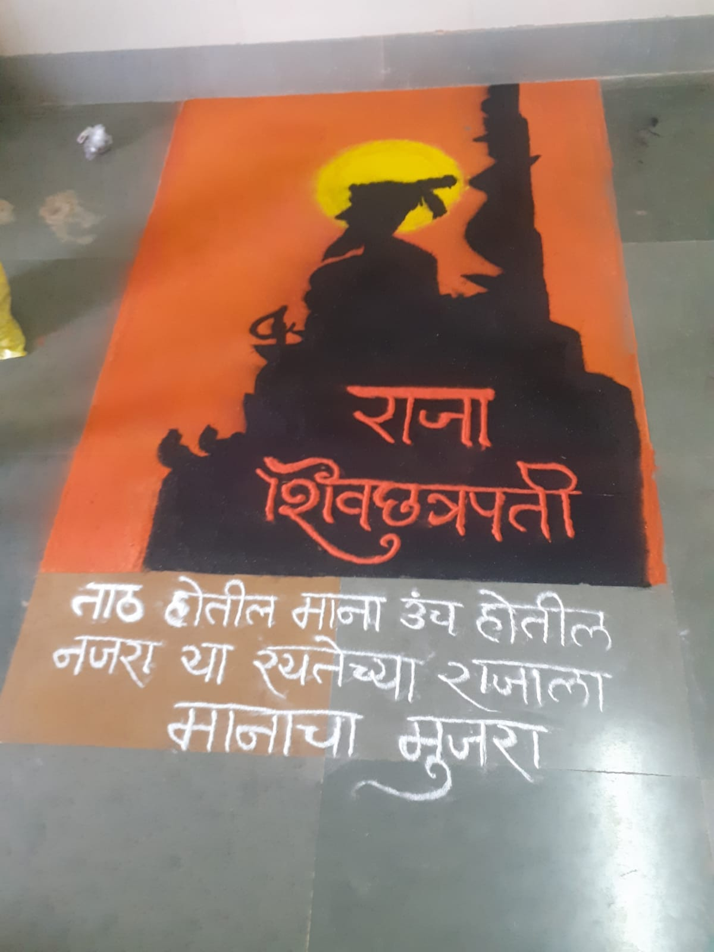
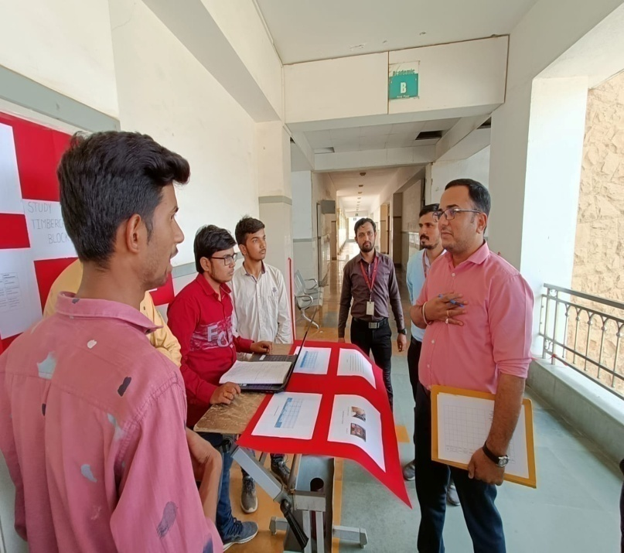
Volume 01 Issue 03
Vision and Mission of the Department
VISION:
To produce professional skilled civil engineers to face the challenges in the engineering field and pursue higher education.
MISSION:
M1:To provide quality infrastructure in the support of a conducive learning environment.
M2:To inculcate the practices towards employability, entrepreneurship and higher education.
M3:To develop a positive attitude, professional and social skills
Competition
Rangoli Competiton
Project Competition
Name of Event:
Rangoli competition.
Date of Expert Lecture:-
16.09.2022
Location:-
Class Room 101 Sandip Polytechnic.
Participants:-
SYCE & TYCE Students
Objectives:-
Skills of students where developed.
Name of Event:
Project competition.
Date of Expert Lecture:-
12.09.2022
Location:-
Drawing Hall Sandip Polytechnic.
Participants:-
SYCE & TYCE Students
Objectives:-
Presentation skill and stage daring will be improved.
Improvement in their ideas and thoughts.

Slide 19
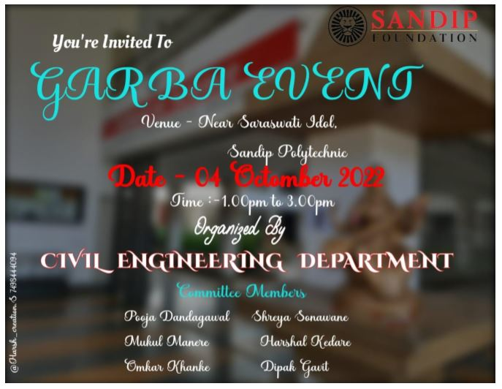
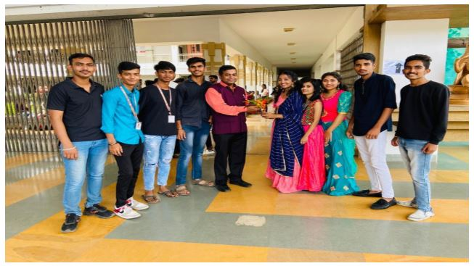
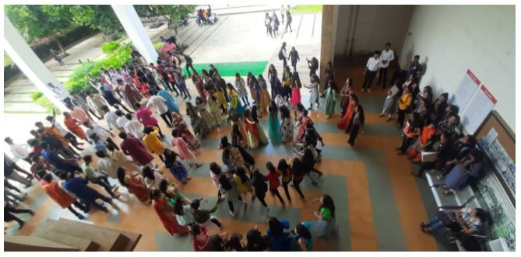
Volume 01 Issue 03
Vision and Mission of the Department
VISION:
To produce professional skilled civil engineers to face the challenges in the engineering field and pursue higher education.
MISSION:
M1:To provide quality infrastructure in the support of a conducive learning environment.
M2:To inculcate the practices towards employability, entrepreneurship and higher education.
M3:To develop a positive attitude, professional and social skills
Garba event 2022
Garba Event 2022
Name of Event:
Non Technical Garba event.
Date of Expert Lecture:-
03.10.2022 & 04.10.2022
Location:-
Entrance of Polytechnic Building.
Participants:-
SYCE & TYCE Students
Objectives:-
Participating in a Garba event allows students to learn about and appreciate Gujarati culture and traditions.
Garba events bring students, teachers, parents, and the broader community together in celebration. It fosters a sense of unity and belonging within the school community, strengthening relationships and social bonds.

Slide 20
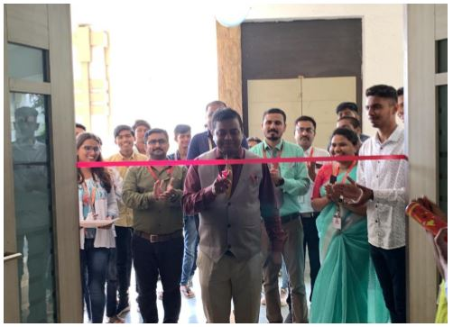
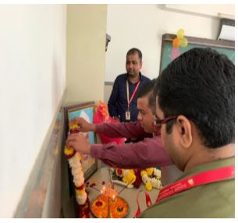
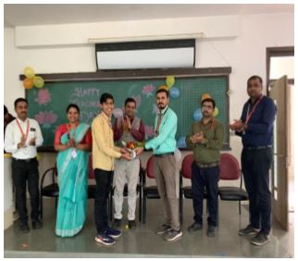
Volume 01 Issue 03
Vision and Mission of the Department
VISION:
To produce professional skilled civil engineers to face the challenges in the engineering field and pursue higher education.
MISSION:
M1:To provide quality infrastructure in the support of a conducive learning environment.
M2:To inculcate the practices towards employability, entrepreneurship and higher education.
M3:To develop a positive attitude, professional and social skills
Teacher’s Day Celebration
Teacher’s Day Celebration
Name of Event:
Teachers Day Celebration..
Date of Expert Lecture:-
05.09.2022
Location:-
203 class room of sandip polytechnic.
Participants:-
SYCE & TYCE Students
Objectives:-
To mark the Birth Anniversary of Dr. Sarvepalli Radhakrishnan.
To raise awareness about the role of teachers in playing quality education at all levels.
To improve skills of students.

Slide 21
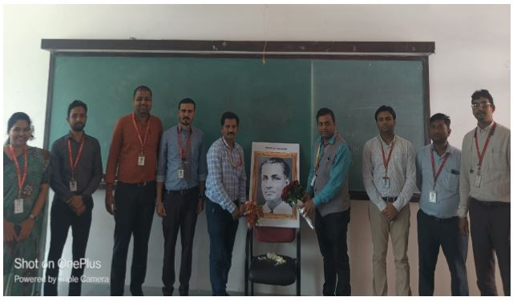
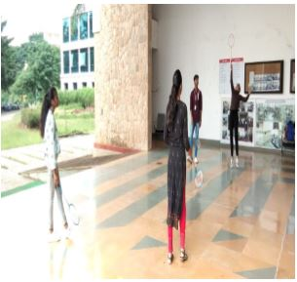
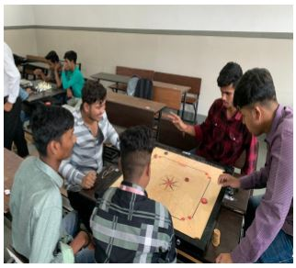
Volume 01 Issue 03
Vision and Mission of the Department
VISION:
To produce professional skilled civil engineers to face the challenges in the engineering field and pursue higher education.
MISSION:
M1:To provide quality infrastructure in the support of a conducive learning environment.
M2:To inculcate the practices towards employability, entrepreneurship and higher education.
M3:To develop a positive attitude, professional and social skills
National Sport Day
National Sport Day
Name of Event:
National Sport Days..
Date of Expert Lecture:-
28.08.2022 & 29.08.2022
Location:-
Ground of Sandip Foundation.
Participants:-
SYCE & TYCE Students
Objectives:-
Popularising sports among the youth.
Increasing public awareness about sports and also impart education to youngsters about the importance of sports.
To establish an important link between the youth, our sport and environmental conservation.

Slide 22
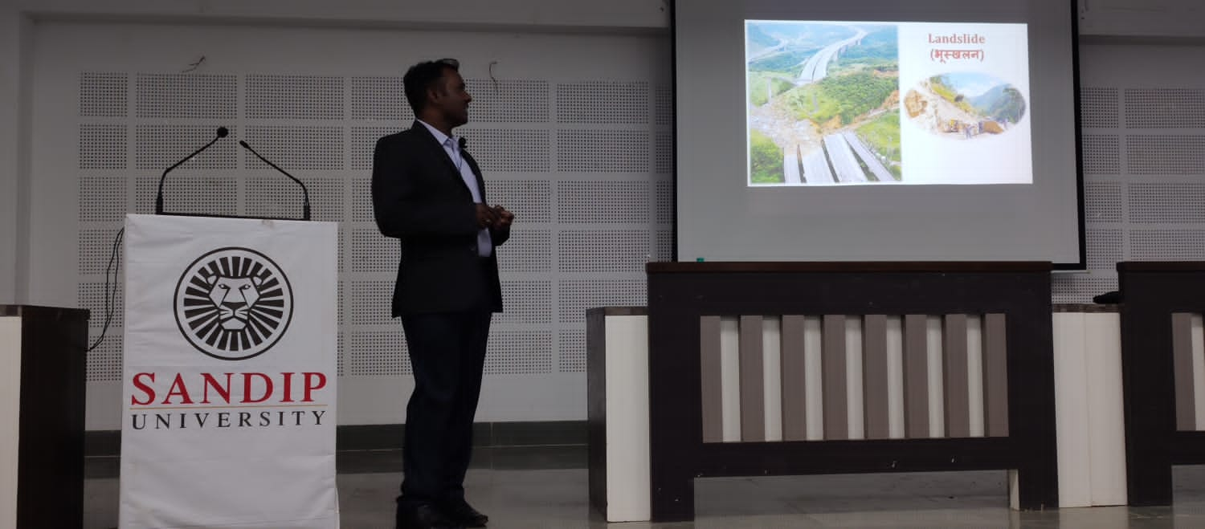
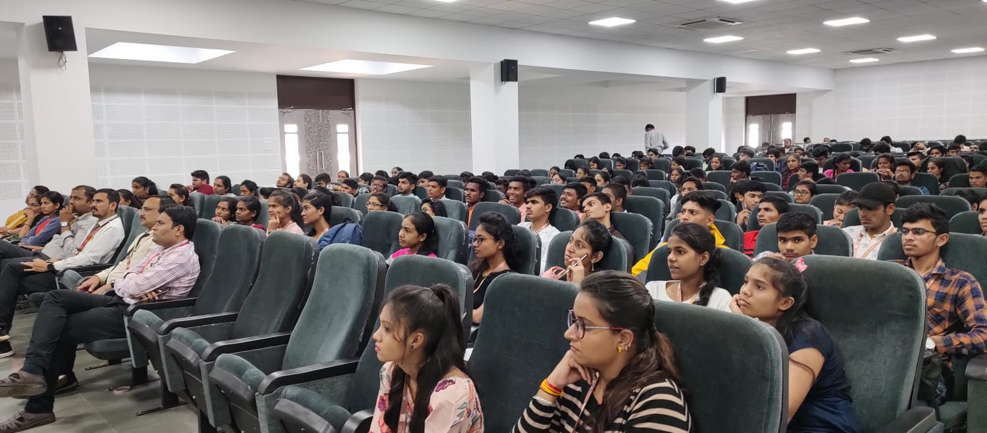
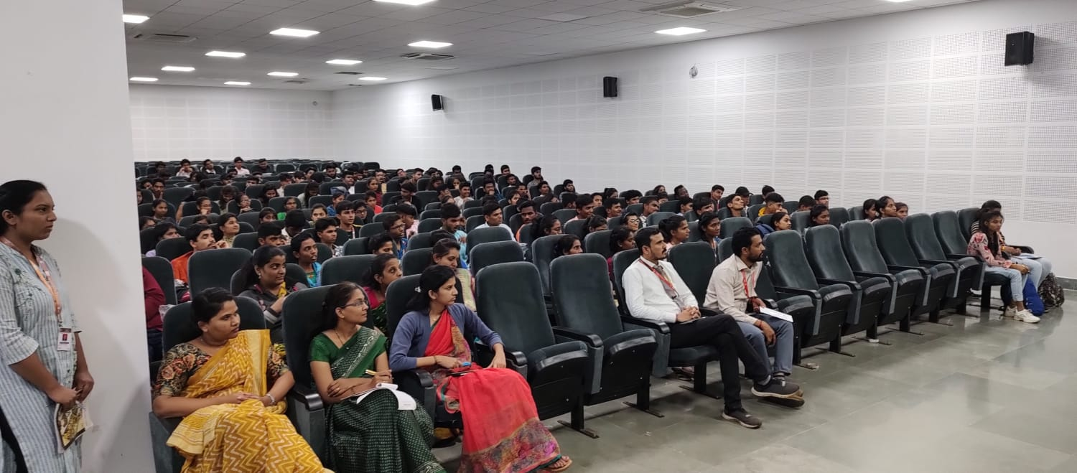
Volume 01 Issue 03
Vision and Mission of the Department
VISION:
To produce professional skilled civil engineers to face the challenges in the engineering field and pursue higher education.
MISSION:
M1:To provide quality infrastructure in the support of a conducive learning environment.
M2:To inculcate the practices towards employability, entrepreneurship and higher education.
M3:To develop a positive attitude, professional and social skills
One Day workshop
One day workshop on publish your manuscript in SCIE Journals
Name of Event:
One day workshop on publish your manuscript in SCIE Journals.
Date of Expert Lecture:-
30.09.2022
Resource Person:-
Dr. Sainath Aher.
Participants:-
SYCE & TYCE Students
Objectives:-
The primary objective of publishing in SCIE journals is to disseminate your research findings to a wide audience of scientists, researchers, academicians, and practitioners worldwide.
Publishing in these journals ensures that your work is accessible to the scientific community and can contribute to the advancement of knowledge in your field.

Slide 23
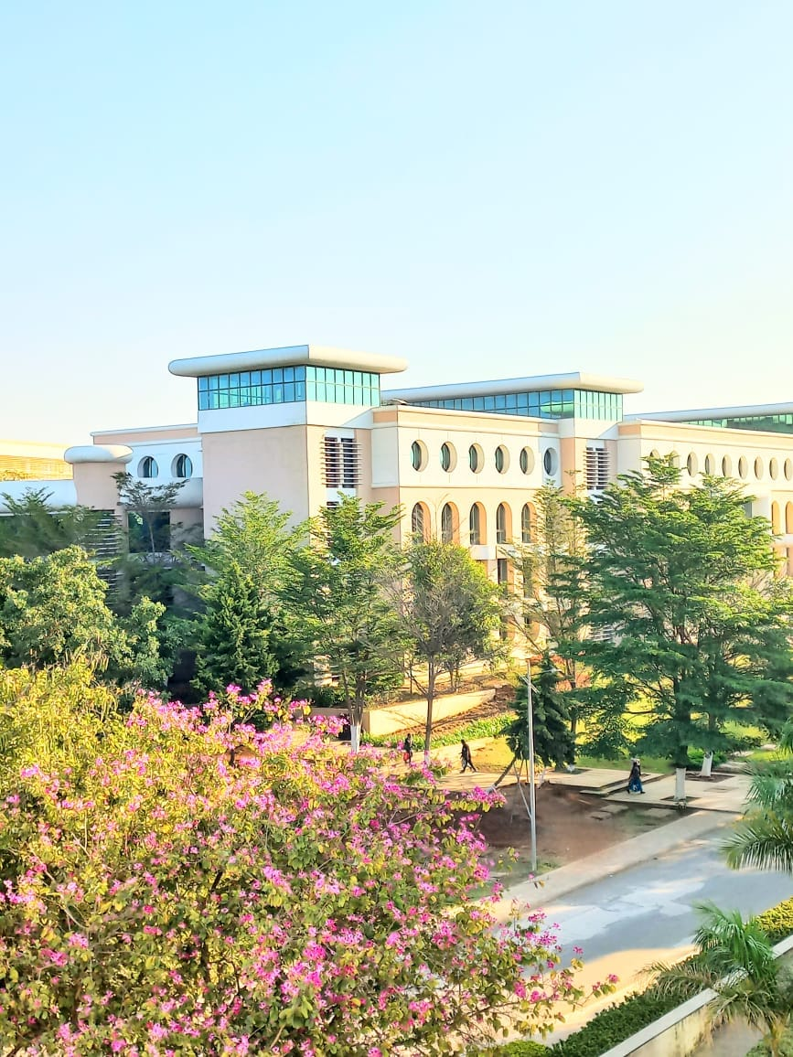
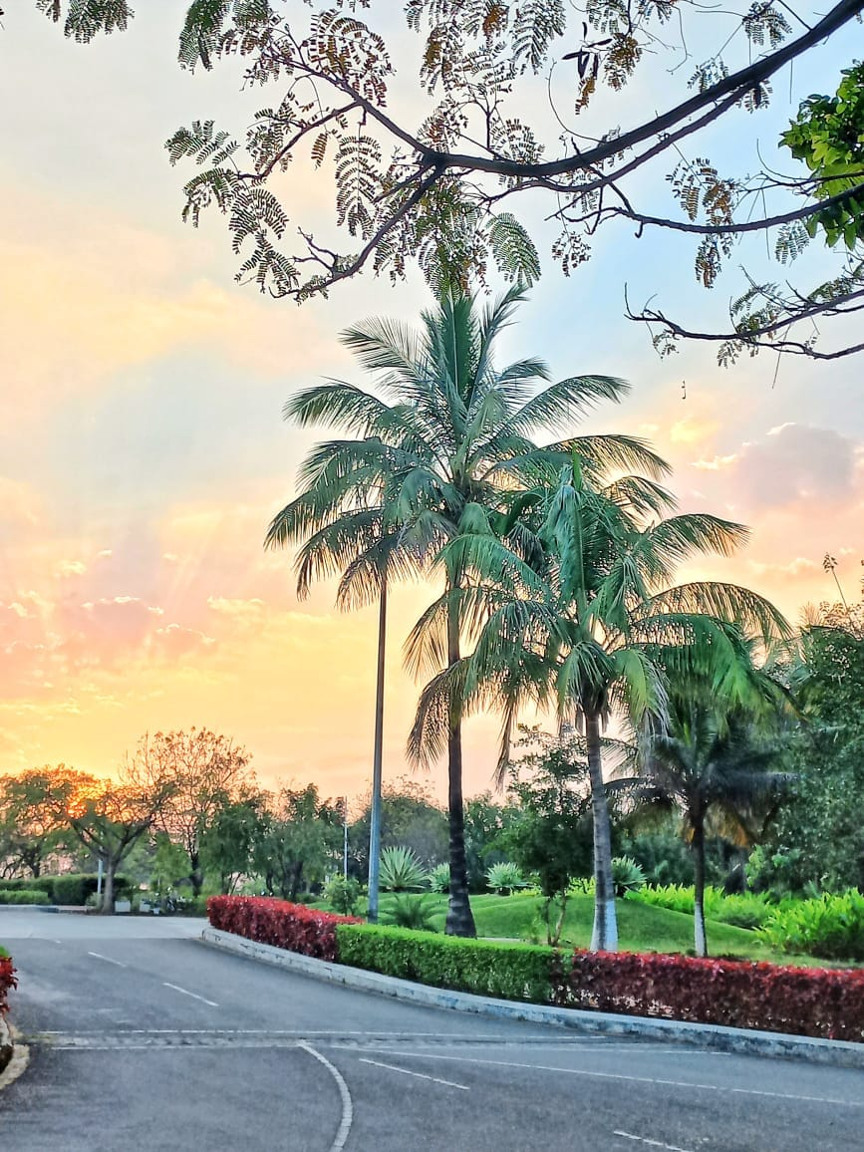
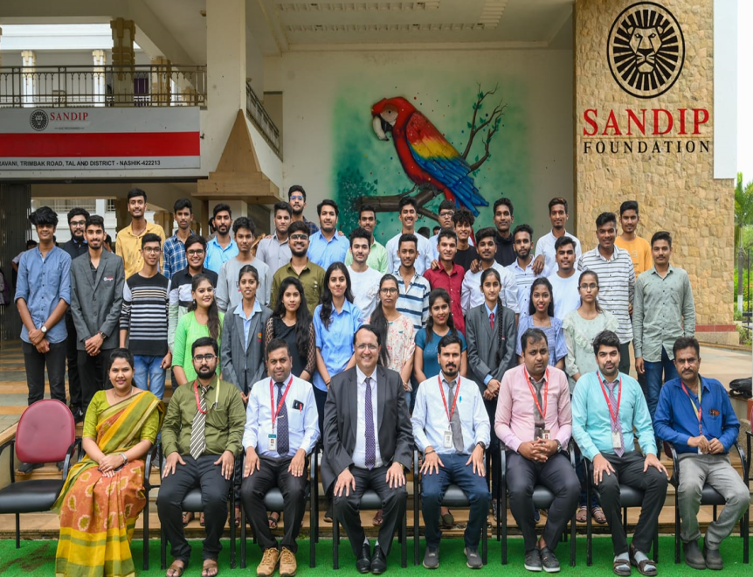
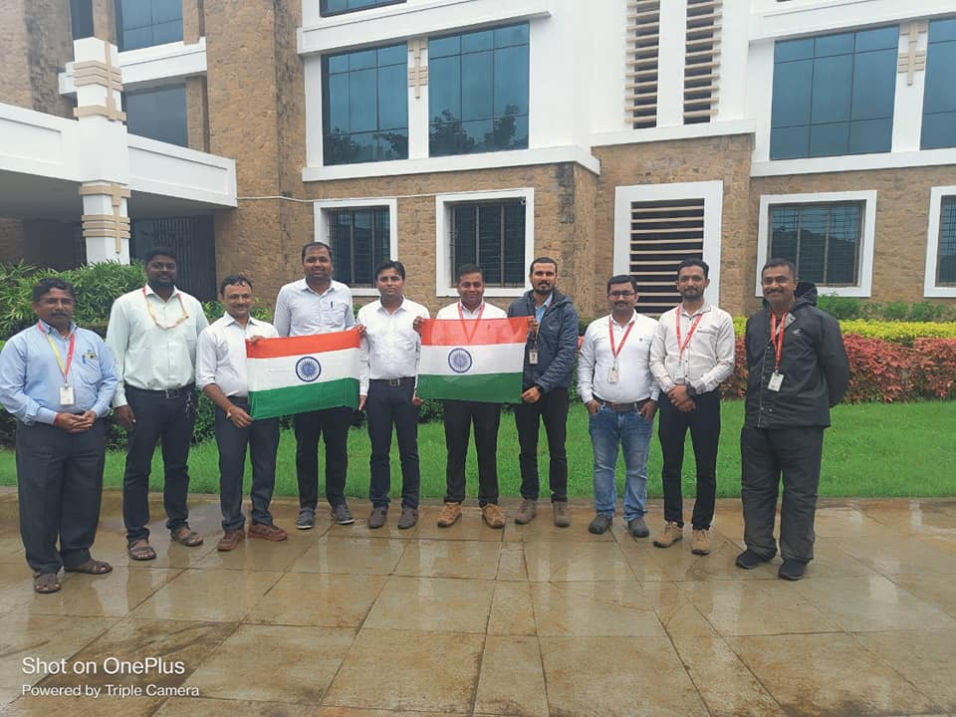
Volume 01 Issue 03
Vision and Mission of the Department
VISION:
To produce professional skilled civil engineers to face the challenges in the engineering field and pursue higher education.
MISSION:
M1:To provide quality infrastructure in the support of a conducive learning environment.
M2:To inculcate the practices towards employability, entrepreneurship and higher education.
M3:To develop a positive attitude, professional and social skills
Students corner
Photography
Photography
Toppers Felicitation
Independence Day

