Slide 1

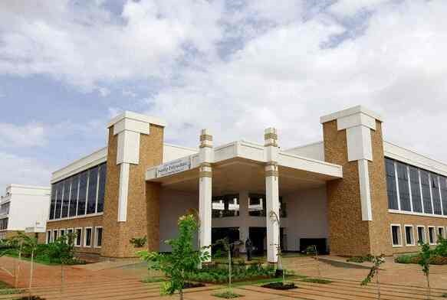
Volume 01 Issue 01
SANDIP POLYTECHNIC
August - December 2021
NEWSLETTER
Vision of Sandip Polytechnic
“To produce skilled technocrats for serving industry, Society and pursue higher education”
Mission of Sandip Polytechnic
M1:State the art of infrastructure, qualified and competent teaching faculty.
M2:To provide industry institute interaction, employability enhancement and higher education.
M3:To provide platform for development professional, social skill and life long learning.
Vision and Mission of the Department
VISION:
To produce professional skilled civil engineers to face the challenges in the engineering field and pursue higher education.
MISSION:
M1: To provide quality infrastructure in the support of a conducive learning environment.
M2: To inculcate the practices towards employability, entrepreneurship and higher education.
M3: To develop a positive attitude, professional and social skills
Leading Polytechnic
College s in Nashik
When you join Sandip Polytechnic (SP) at Sandip Foundation, you are joining one of the top polytechnic colleges in Maharashtra and indeed the best polytechnic college in Nashik.
If you want to fast track your career and fast track yourself to success then there’s just one and only one place and that’s Sandip Polytechnic. Our motivation to help you become ‘insanely’ great at what you do, achieve your imagination.
Editorial Board Members
Prof. V. O. Patil
Prof. B. G. Abhale

Slide 2

Volume 01 Issue 01
Vision and Mission of the Department
VISION:
To produce professional skilled civil engineers to face the challenges in the engineering field and pursue higher education.
MISSION:
M1:To provide quality infrastructure in the support of a conducive learning environment.
M2:To inculcate the practices towards employability, entrepreneurship and higher education.
M3:To develop a positive attitude, professional and social skills
WHAT’S INSIDE
02. HOD Message
03. Editors Information
04. About Civil Department
05. Lab Information
06. Toppers
07. Industrial Visits
08. Expert Lectures
09. Competition
01. Chairman’s Message
10. Workshops
10. Students Corner

Slide 3
Volume 01 Issue 01
Vision and Mission of the Department
VISION:
To produce professional skilled civil engineers to face the challenges in the engineering field and pursue higher education.
MISSION:
M1:To provide quality infrastructure in the support of a conducive learning environment.
M2:To inculcate the practices towards employability, entrepreneurship and higher education.
M3:To develop a positive attitude, professional and social skills
Learn from your experiences for these is no greater tutor than life itself.
From Chairman’s Desk
Learn from your experience, for there is no greater tutor than life itself. I am happy to pen down a few words as prologue to our Newsletter which is exclusively meant for churning out the latent writing talent which bears immense potentiality of sharpening our students’ skills as part of their overall personality development. I congratulate all the team members and contributors of this Newsletter for bringing out such a beautiful Newsletter. Walk with those who feed your mind with motivation to further your mission. Wake up hungry for success every day; your drive for success must match the ferocity of a hungry lion attacking his prey every morning. An educated person without morals is like a room without windows. I think that morals are what ground us as a society, and without morals we would have no light to guide our educated minds. We, at Sandip Foundation, strive to make our students reliable technocrats and trustworthy citizens of India. My staunch faith and conviction is that our students would carve a niche in their career and life by going lineage and heritage through this temple of learning. I would like to take this opportunity to reiterate that there is no substitute to hard work in any venture. Therefore, it should be our endeavor to give our best in our areas of responsibilities and aim at achieving excellence for our institution. I wish all success to this venture.
HON’BLE DR. SANDIP N. JHA
Chairman, Sandip Foundation

Slide 4

Volume 01 Issue 01
Vision and Mission of the Department
VISION:
To produce professional skilled civil engineers to face the challenges in the engineering field and pursue higher education.
MISSION:
M1:To provide quality infrastructure in the support of a conducive learning environment.
M2:To inculcate the practices towards employability, entrepreneurship and higher education.
M3:To develop a positive attitude, professional and social skills
HOD Civil Engineering Department Massage
From HOD’s Desk
I welcome you all to Sandip Polytechnic, the institution which has set the benchmark for quality teaching learning process. The institute strives to provide the world class faculties and facilities so that we will see you all blossom into empowered and sensitive human being. Education is the manifestation of love and my most cherished possession. It drives away the ignorance and through illumination it emboldens a man to a righteous thought and action. It energizes a society and enables a man to earn his living with respect and praise. In order to accomplish our vision and mission, we are prepared to take as much effort as possible for the betterment of academic scenario in India. Our institute cares for the individual development of each and every student. We follow the mentor system under which each class is put into multi-prolonged web of a teacher. We accord prime importance to the behavioral discipline, moral integrity and cognitive developments of our students. Our faculties strive to teach not only academic programs but also life skills needed for students.
Dr. Prof. VILAS NIKAM,
Vice Principal HODCE

Slide 5
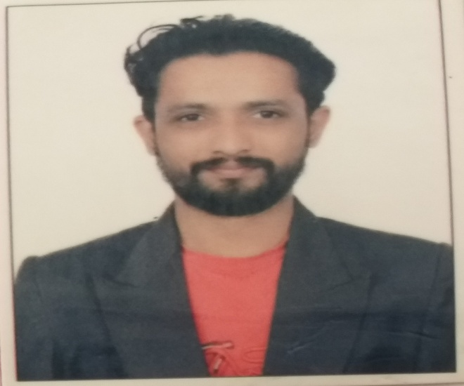
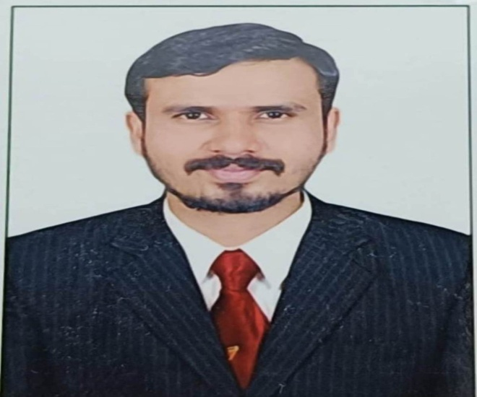
Volume 01 Issue 01
Vision and Mission of the Department
VISION:
To produce professional skilled civil engineers to face the challenges in the engineering field and pursue higher education.
MISSION:
M1:To provide quality infrastructure in the support of a conducive learning environment.
M2:To inculcate the practices towards employability, entrepreneurship and higher education.
M3:To develop a positive attitude, professional and social skills
Prof. V. O. Patil
ME (Structure)
vikas.patil@sandippolytechnic.org
9511940099
Prof. B. G. Abhale
ME (Environment)
bhanudas.abhale@sandippolytechnic.org
9423042624

Slide 6
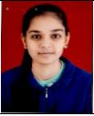
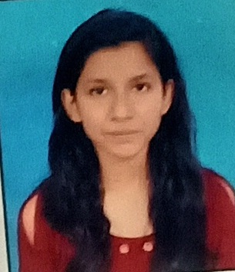
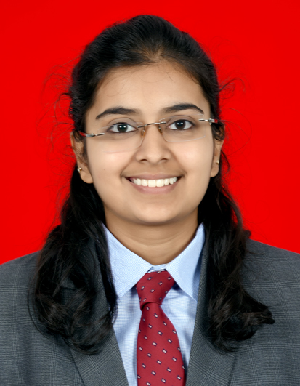
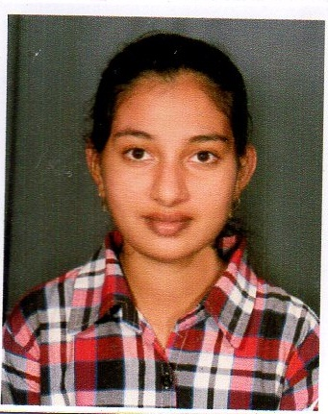
Volume 01 Issue 01
Vision and Mission of the Department
VISION:
To produce professional skilled civil engineers to face the challenges in the engineering field and pursue higher education.
MISSION:
M1:To provide quality infrastructure in the support of a conducive learning environment.
M2:To inculcate the practices towards employability, entrepreneurship and higher education.
M3:To develop a positive attitude, professional and social skills
Students Details FY-SY-TY
SAKSHI SHARAD SHINDE
ISHA PRASHANT NAIKWADE
RUCHI RAHUL CHAVAN
VIDYA GANPAT KATORE

Slide 7
Volume 01 Issue 01
Vision and Mission of the Department
VISION:
To produce professional skilled civil engineers to face the challenges in the engineering field and pursue higher education.
MISSION:
M1:To provide quality infrastructure in the support of a conducive learning environment.
M2:To inculcate the practices towards employability, entrepreneurship and higher education.
M3:To develop a positive attitude, professional and social skills
About Civil engineering department
Civil Engineering is a Professional Engineering discipline that deals with the design, construction and maintenance of the physically and naturally built environment, including works such as bridges, roads, canals, dams and buildings. Civil Engineering is the oldest Engineering Discipline after Military Engineering. It is traditionally broken into different disciplines including Environmental Engineering, Structural Engineering, Transportation Engineering, Water Resource Engineering, Geo-technical Engineering, Material Engineering, Survey Engineering and Construction Engineering. Civil Engineering takes place at all levels in the public sector and private sector.
Department Information
Programme:- Civil Engineering
Year of Establishment:- 2009
Intake Capacity:- 120
General Choice Code:- 525819110
TFWS Choice Code:- 525819111T

Slide 8
Volume 01 Issue 01
Vision and Mission of the Department
VISION:
To produce professional skilled civil engineers to face the challenges in the engineering field and pursue higher education.
MISSION:
M1:To provide quality infrastructure in the support of a conducive learning environment.
M2:To inculcate the practices towards employability, entrepreneurship and higher education.
M3:To develop a positive attitude, professional and social skills
Civil engineering LAB Details
Sr. No. | Name of Lab | Location | Cost of Lab
1 | Mechanics of Structure Lab | Ground Floor | 1082264
2 | Hydraulics Lab (Fluid Mechanics) | Ground Floor | 256497
3 | Geotechnical Engineering Lab | Ground Floor | 632350
4 | Concrete Technology Lab | Ground Floor | 845622
5 | Surveying Lab | Ground Floor | 1201804
6 | Public Health Engineering Lab | First Floor | 199615
7 | Model Lab | First Floor | 183141
8 | Engineering Mechanics Lab | First Floor | 314878
9 | Highway Engineering Lab | First Floor | 108821
10 | CAD Lab | First Floor | --

Slide 9
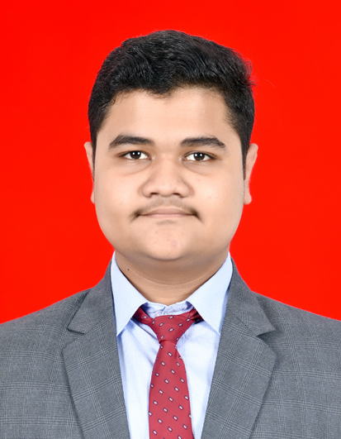
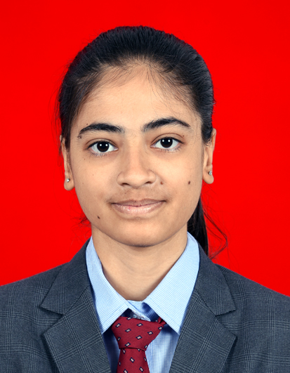
Volume 01 Issue 01
Vision and Mission of the Department
VISION:
To produce professional skilled civil engineers to face the challenges in the engineering field and pursue higher education.
MISSION:
M1:To provide quality infrastructure in the support of a conducive learning environment.
M2:To inculcate the practices towards employability, entrepreneurship and higher education.
M3:To develop a positive attitude, professional and social skills
Civil engineering Toppers TYCE S-20
Sr. No | Name of Student | Enrolment No | Class | % | Photos
1 | RUCHI RAHUL CHAVAN | 1711670063 | TYCE | 92.70
2 | TATPURKAR EKTA BHARAT | 1711670001 | TYCE | 90.80
3 | RUSHIK SHAILESH BHAI MARU | 1711670004 | TYCE | 87.60

Slide 10
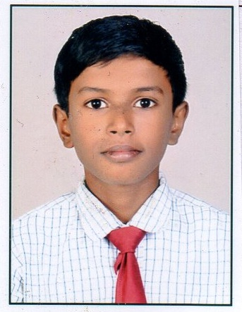
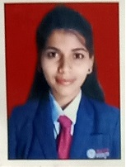
Volume 01 Issue 01
Vision and Mission of the Department
VISION:
To produce professional skilled civil engineers to face the challenges in the engineering field and pursue higher education.
MISSION:
M1:To provide quality infrastructure in the support of a conducive learning environment.
M2:To inculcate the practices towards employability, entrepreneurship and higher education.
M3:To develop a positive attitude, professional and social skills
Civil engineering Toppers SYCE S-20
Sr. No | Name of Student | Enrolment No | Class | % | Photos
1 | KATORE VIDYA GANPAT | 1811670072 | SYCE | 94.25
2 | KAPSE POOJA DINKAR | 1911670108 | SYCE | 94.00
3 | VALVI VIVEKKUMAR MAHENDRABHAI | 1811670009 | SYCE | 93.38

Slide 11
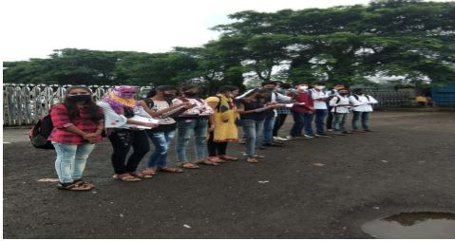
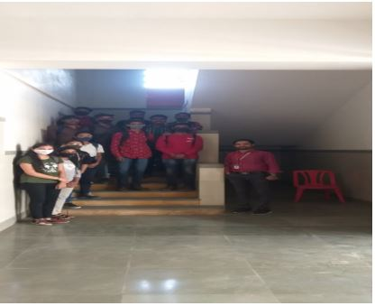
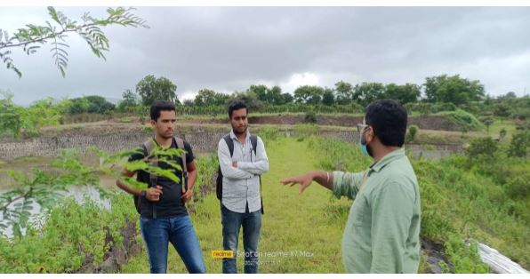
Volume 01 Issue 01
Vision and Mission of the Department
VISION:
To produce professional skilled civil engineers to face the challenges in the engineering field and pursue higher education.
MISSION:
M1:To provide quality infrastructure in the support of a conducive learning environment.
M2:To inculcate the practices towards employability, entrepreneurship and higher education.
M3:To develop a positive attitude, professional and social skills
Industrial Visits
Traffic Volume Study
Building Construction
Earthen Dam
Name of Event:
Traffic Volume Study Visit.
Date of Visit:-
15.10.2021
Visit Location:-
Sandip Foundation Gate
Participants:-
SYCE Students
Objectives:-
To understand the Traffic Volume importance at intersections and use of count of vehicles (use of data while design roads).
Name of Event:
Building Construction Sub Structure & Super Structure
Date of Visit:-
16.11.2021
Visit Location:-
Sandip Foundation “O” Building
Participants:-
SYCE Students
Objectives:-
To understand the Different Component parts of Building.
Name of Event:
Earthen Dam Visit.
Date of Visit:-
17.09.2021
Visit Location:-
Sandip Foundation Nilam Sagar Dam.
Participants:-
TYCE Students
Objectives:-
To understand the Different Components parts of Earthen Dam.

Slide 12
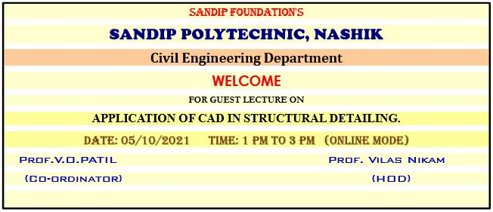
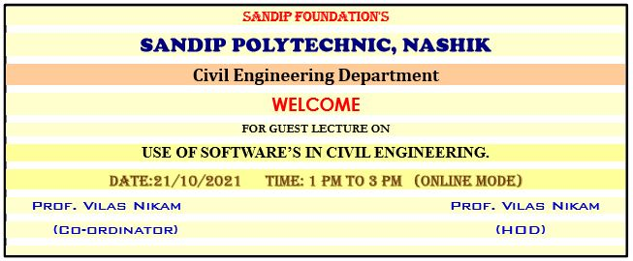
Volume 01 Issue 01
Vision and Mission of the Department
VISION:
To produce professional skilled civil engineers to face the challenges in the engineering field and pursue higher education.
MISSION:
M1:To provide quality infrastructure in the support of a conducive learning environment.
M2:To inculcate the practices towards employability, entrepreneurship and higher education.
M3:To develop a positive attitude, professional and social skills
Expert Lectures
Application of CAD in Structural Detailing
Use of Software's in Civil Engineering
Name of Event:
Application of CAD in Structural Detailing.
Date of Expert Lecture:-
05.10.2021
Resource Person:-
Prof. V. N. Nikam
Participants:-
SYCE & TYCE Students
Objectives:-
1. To understand the role of soft computing techniques in the field of civil engineering.
2. To understand the smart tricks to enhance the efficiency of working with auto cad.
3. To understand the vital role of AUTO CAD software in the filed of detailing of RCC, Steel etc. detailing
Name of Event:
Use of Software's in Civil Engineering.
Date of Expert Lecture:-
21.10.2021
Resource Person:-
Er. Nitin Avhad
Participants:-
SYCE & TYCE Students
Objectives:-
1. To understand the role of soft computing techniques in the field of civil engineering.
2. To understand the vital role of different software which are used for different work of civil engineering like BIM
3. To understand the benefits of soft computing techniques over pen paper method.

Slide 13
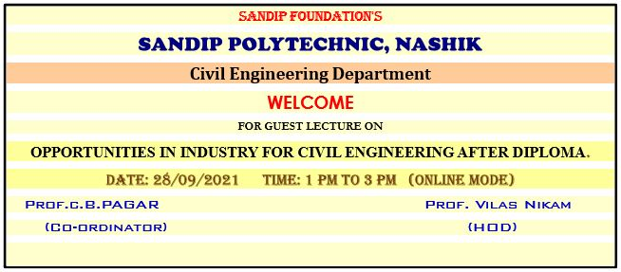
Volume 01 Issue 01
Vision and Mission of the Department
VISION:
To produce professional skilled civil engineers to face the challenges in the engineering field and pursue higher education.
MISSION:
M1:To provide quality infrastructure in the support of a conducive learning environment.
M2:To inculcate the practices towards employability, entrepreneurship and higher education.
M3:To develop a positive attitude, professional and social skills
Expert Lectures
Opportunities in Industry for Civil Engineering After Diploma
Name of Event:
Opportunities in Industry for Civil Engineering After Diploma.
Date of Expert Lecture:-
28.09.2021
Resource Person:-
Er. Sharad Pagar
Participants:-
SYCE & TYCE Students
Objectives:-
1. To understand the role of civil engineer after the diploma education in construction industry.
To understand the role of civil engineering field in the economy of country.
To understand the opportunities available in the market for the civil engineer in various sector.

Slide 14
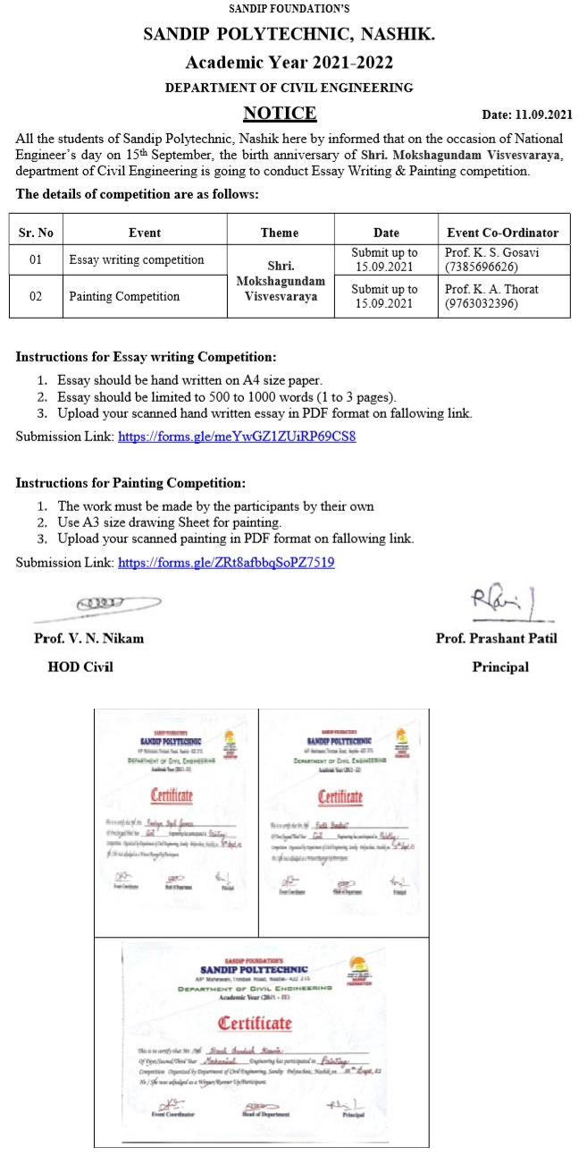
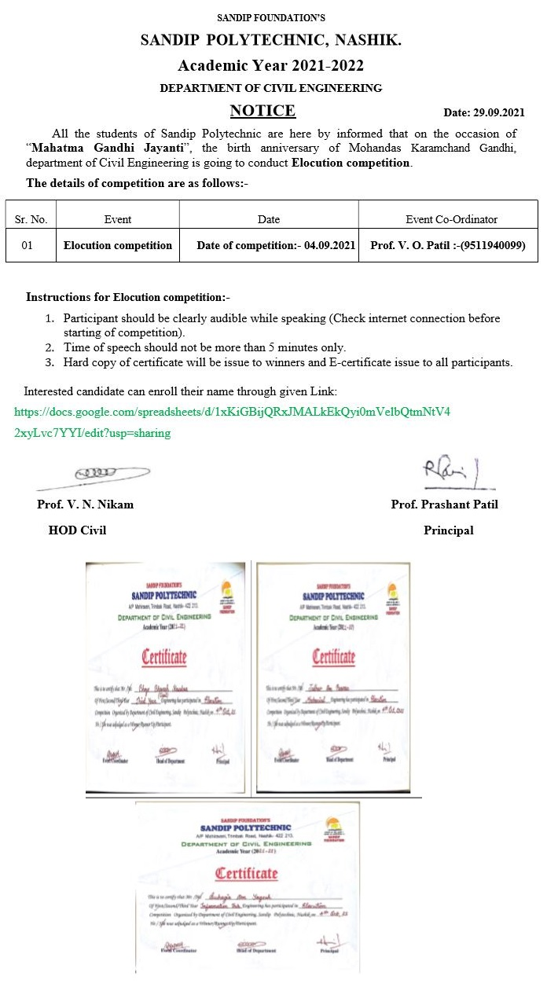
Volume 01 Issue 01
Vision and Mission of the Department
VISION:
To produce professional skilled civil engineers to face the challenges in the engineering field and pursue higher education.
MISSION:
M1:To provide quality infrastructure in the support of a conducive learning environment.
M2:To inculcate the practices towards employability, entrepreneurship and higher education.
M3:To develop a positive attitude, professional and social skills
Competitions
Essay Writing & Painting Competition
Elocution Competition

Slide 15
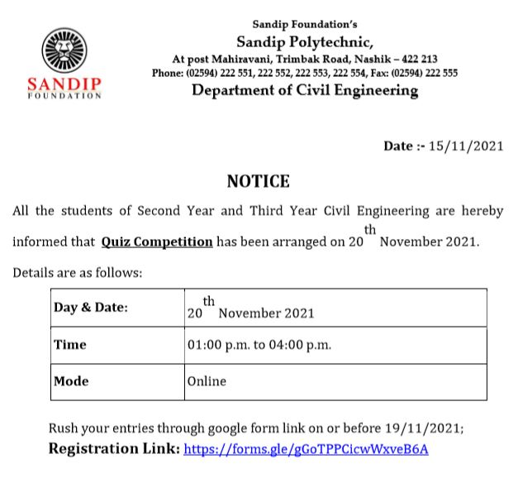
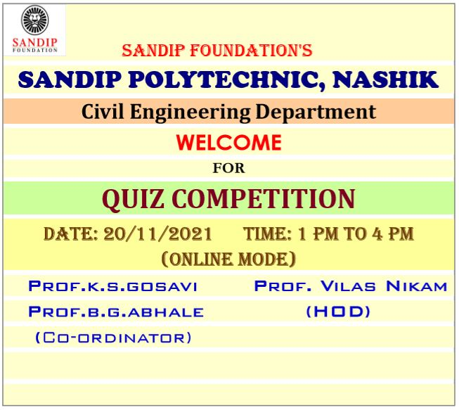
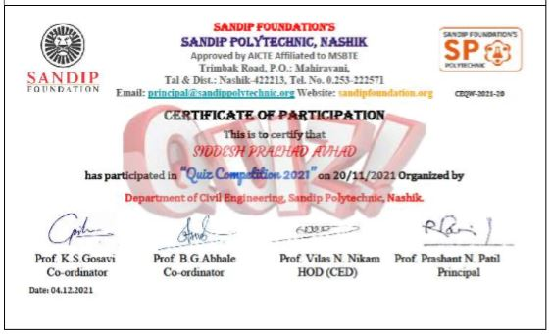
Volume 01 Issue 01
Vision and Mission of the Department
VISION:
To produce professional skilled civil engineers to face the challenges in the engineering field and pursue higher education.
MISSION:
M1:To provide quality infrastructure in the support of a conducive learning environment.
M2:To inculcate the practices towards employability, entrepreneurship and higher education.
M3:To develop a positive attitude, professional and social skills
Competitions
Quiz Competition

Slide 16
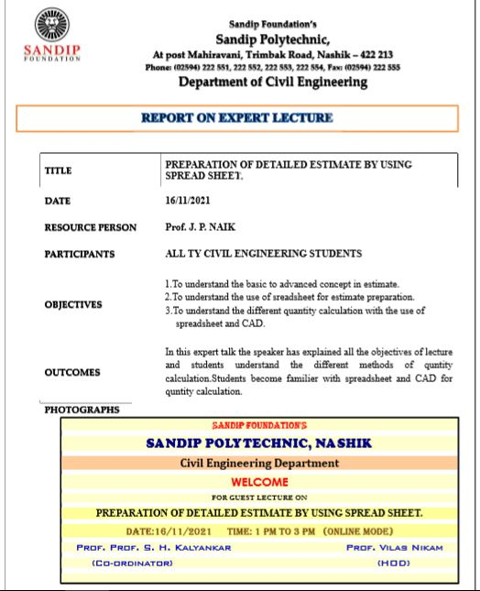
Volume 01 Issue 01
Vision and Mission of the Department:
VISION:
To produce professional skilled civil engineers to face the challenges in the engineering field and pursue higher education.
MISSION:
M1:To provide quality infrastructure in the support of a conducive learning environment.
M2:To inculcate the practices towards employability, entrepreneurship and higher education.
M3:To develop a positive attitude, professional and social skills
Workshop one day
Preparation of Detailed Estimate by using Spread Sheet

Slide 17
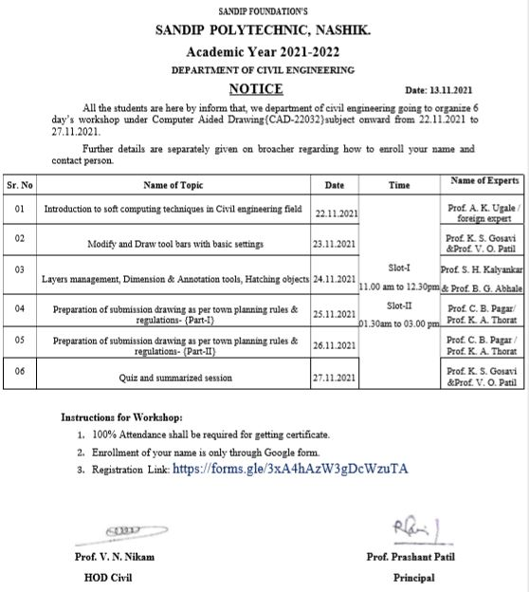
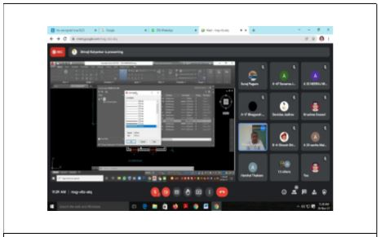
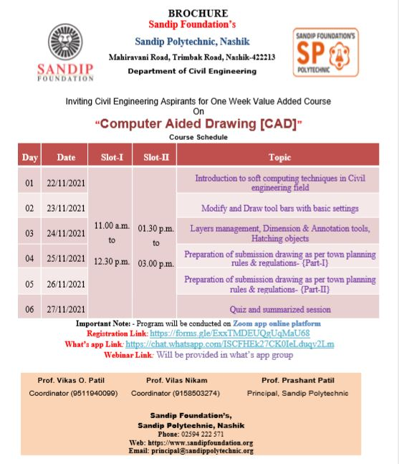
Volume 01 Issue 01
Vision and Mission of the Department:
VISION:
To produce professional skilled civil engineers to face the challenges in the engineering field and pursue higher education.
MISSION:
M1:To provide quality infrastructure in the support of a conducive learning environment.
M2:To inculcate the practices towards employability, entrepreneurship and higher education.
M3:To develop a positive attitude, professional and social skills
Workshop six days
CAD Workshop

Slide 18
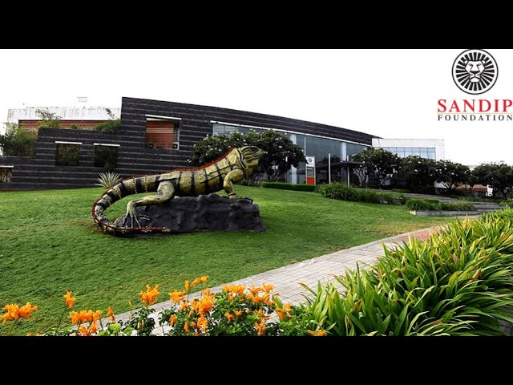
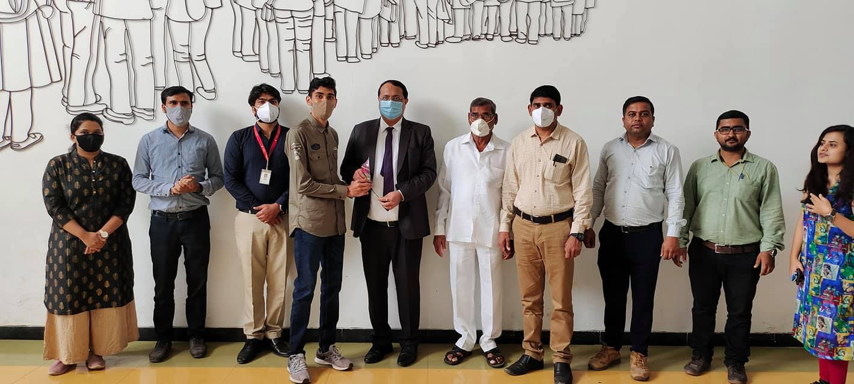
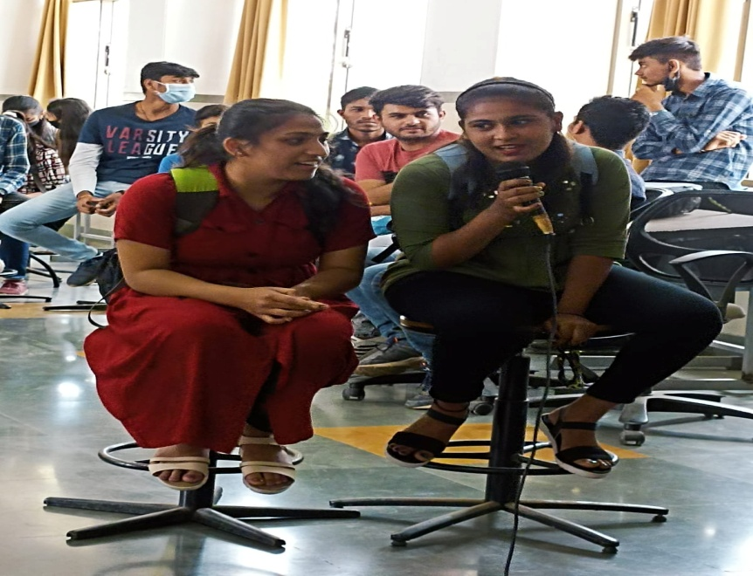
Volume 01 Issue 01
Vision and Mission of the Department
VISION:
To produce professional skilled civil engineers to face the challenges in the engineering field and pursue higher education.
MISSION:
M1:To provide quality infrastructure in the support of a conducive learning environment.
M2:To inculcate the practices towards employability, entrepreneurship and higher education.
M3:To develop a positive attitude, professional and social skills
Students corner
Poem
Photography
विद्येच्या पाठांच्या मोठ्या अंगणात, ज्ञानाच्या ध्वज वाहतो, आकाशात तारांच्या सोने, विद्यार्थी मन आनंदात ओढतो।
पुस्तकांच्या समुद्रात आणि लेक्चर्सांच्या जलधारात, विद्यार्थी मन कथा सुंदर ओळखतो, नाना जगांना साखरेच्या अन्नाने भरतो।
Toppers Felicitation
Singing

