Slide 1
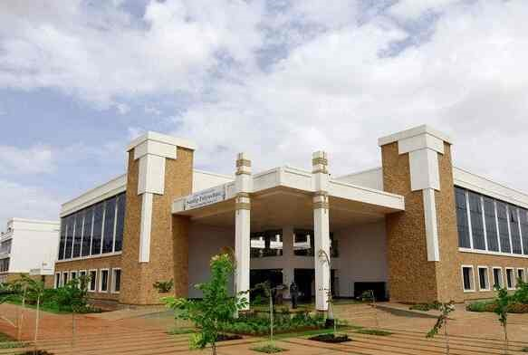
Volume 01 Issue 05
SANDIP POLYTECHNIC
August - December 2023
NEWSLETTER
Vision of Sandip Polytechnic
“To produce skilled technocrats for serving industry, Society and pursue higher education”
Mission of Sandip Polytechnic
M1 : State the art of infrastructure, qualified and competent teaching faculty.
M2 : To provide industry institute interaction, employability enhancement and higher education.
M3 : To provide platform for development professional, social skill and life long learning.
Vision and Mission of the Department
VISION:
To produce professional skilled civil engineers to face the challenges in the engineering field and pursue higher education.
MISSION:
M1: To provide quality infrastructure in the support of a conducive learning environment.
M2: To inculcate the practices towards employability, entrepreneurship and higher education.
M3: To develop a positive attitude, professional and social skills
Leading Polytechnic
College s in Nashik
When you join Sandip Polytechnic (SP) at Sandip Foundation, you are joining one of the top polytechnic colleges in Maharashtra and indeed the best polytechnic college in Nashik.
If you want to fast track your career and fast track yourself to success then there’s just one and only one place and that’s Sandip Polytechnic. Our motivation to help you become ‘insanely’ great at what you do, achieve your imagination.
Editorial Board Members
Prof. V. O. Patil
Prof. B. G. Abhale

Slide 2
Volume 01 Issue 05
Vision and Mission of the Department
VISION:
To produce professional skilled civil engineers to face the challenges in the engineering field and pursue higher education.
MISSION:
M1:To provide quality infrastructure in the support of a conducive learning environment.
M2:To inculcate the practices towards employability, entrepreneurship and higher education.
M3:To develop a positive attitude, professional and social skills
WHAT’S INSIDE
02. HOD Message
03. Editors Information
04. About Civil Department
05. Lab Information
06. Toppers
07. Expert Lecture
08. Industrial Visit
01. Chairman’s Message
08. Six days Workshop
08. Competitions

Slide 3
Volume 01 Issue 05
Vision and Mission of the Department
VISION:
To produce professional skilled civil engineers to face the challenges in the engineering field and pursue higher education.
MISSION:
M1:To provide quality infrastructure in the support of a conducive learning environment.
M2:To inculcate the practices towards employability, entrepreneurship and higher education.
M3:To develop a positive attitude, professional and social skills
Learn from your experiences for these is no greater tutor than life itself.
From Chairman’s Desk
Learn from your experience, for there is no greater tutor than life itself. I am happy to pen down a few words as prologue to our Newsletter which is exclusively meant for churning out the latent writing talent which bears immense potentiality of sharpening our students’ skills as part of their overall personality development. I congratulate all the team members and contributors of this Newsletter for bringing out such a beautiful Newsletter. Walk with those who feed your mind with motivation to further your mission. Wake up hungry for success every day; your drive for success must match the ferocity of a hungry lion attacking his prey every morning. An educated person without morals is like a room without windows. I think that morals are what ground us as a society, and without morals we would have no light to guide our educated minds. We, at Sandip Foundation, strive to make our students reliable technocrats and trustworthy citizens of India. My staunch faith and conviction is that our students would carve a niche in their career and life by going lineage and heritage through this temple of learning. I would like to take this opportunity to reiterate that there is no substitute to hard work in any venture. Therefore, it should be our endeavor to give our best in our areas of responsibilities and aim at achieving excellence for our institution. I wish all success to this venture.
HON’BLE DR. SANDIP N. JHA
Chairman, Sandip Foundation

Slide 4
Volume 01 Issue 05
Vision and Mission of the Department
VISION:
To produce professional skilled civil engineers to face the challenges in the engineering field and pursue higher education.
MISSION:
M1:To provide quality infrastructure in the support of a conducive learning environment.
M2:To inculcate the practices towards employability, entrepreneurship and higher education.
M3:To develop a positive attitude, professional and social skills
HOD Civil Engineering Department Massage
From HOD’s Desk
I welcome you all to Sandip Polytechnic, the institution which has set the benchmark for quality teaching learning process. The institute strives to provide the world class faculties and facilities so that we will see you all blossom into empowered and sensitive human being. Education is the manifestation of love and my most cherished possession. It drives away the ignorance and through illumination it emboldens a man to a righteous thought and action. It energizes a society and enables a man to earn his living with respect and praise. In order to accomplish our vision and mission, we are prepared to take as much effort as possible for the betterment of academic scenario in India. Our institute cares for the individual development of each and every student. We follow the mentor system under which each class is put into multi-prolonged web of a teacher. We accord prime importance to the behavioral discipline, moral integrity and cognitive developments of our students. Our faculties strive to teach not only academic programs but also life skills needed for students.
Dr. Prof. VILAS NIKAM,
Vice Principal HODCE

Slide 5
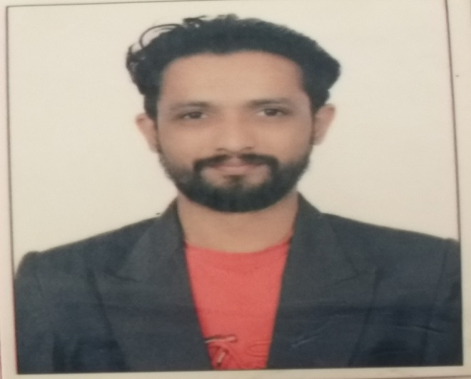
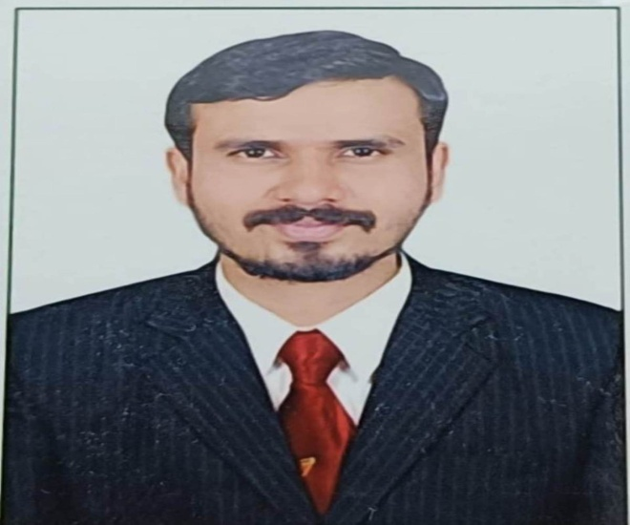
Volume 01 Issue 05
Vision and Mission of the Department
VISION:
To produce professional skilled civil engineers to face the challenges in the engineering field and pursue higher education.
MISSION:
M1:To provide quality infrastructure in the support of a conducive learning environment.
M2:To inculcate the practices towards employability, entrepreneurship and higher education.
M3:To develop a positive attitude, professional and social skills
Editors Information
Prof. V. O. Patil
ME (Structure)
vikas.patil@sandippolytechnic.org
9511940099
Prof. B. G. Abhale
ME (Environment)
bhanudas.abhale@sandippolytechnic.org
9423042624

Slide 6
Volume 01 Issue 05
Vision and Mission of the Department
VISION:
To produce professional skilled civil engineers to face the challenges in the engineering field and pursue higher education.
MISSION:
M1:To provide quality infrastructure in the support of a conducive learning environment.
M2:To inculcate the practices towards employability, entrepreneurship and higher education.
M3:To develop a positive attitude, professional and social skills
About Civil engineering department
Civil Engineering is a Professional Engineering discipline that deals with the design, construction and maintenance of the physically and naturally built environment, including works such as bridges, roads, canals, dams and buildings. Civil Engineering is the oldest Engineering Discipline after Military Engineering. It is traditionally broken into different disciplines including Environmental Engineering, Structural Engineering, Transportation Engineering, Water Resource Engineering, Geo-technical Engineering, Material Engineering, Survey Engineering and Construction Engineering. Civil Engineering takes place at all levels in the public sector and private sector.
Department Information
Programme:- Civil Engineering
Year of Establishment:- 2009
Intake Capacity:- 120
General Choice Code:- 525819110
TFWS Choice Code:- 525819111T

Slide 7
Volume 01 Issue 05
Vision and Mission of the Department
VISION:
To produce professional skilled civil engineers to face the challenges in the engineering field and pursue higher education.
MISSION:
M1:To provide quality infrastructure in the support of a conducive learning environment.
M2:To inculcate the practices towards employability, entrepreneurship and higher education.
M3:To develop a positive attitude, professional and social skills
Civil engineering LAB Details
Sr. No. | Name of Lab | Location | Cost of Lab
1 | Mechanics of Structure Lab | Ground Floor | 1082264
2 | Hydraulics Lab (Fluid Mechanics) | Ground Floor | 256497
3 | Geotechnical Engineering Lab | Ground Floor | 632350
4 | Concrete Technology Lab | Ground Floor | 845622
5 | Surveying Lab | Ground Floor | 1201804
6 | Public Health Engineering Lab | First Floor | 199615
7 | Model Lab | First Floor | 183141
8 | Engineering Mechanics Lab | First Floor | 314878
9 | Highway Engineering Lab | First Floor | 108821
10 | CAD Lab | First Floor | --

Slide 8
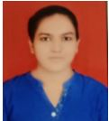
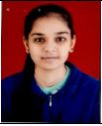
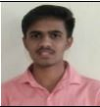
Volume 01 Issue 05
Vision and Mission of the Department
VISION:
To produce professional skilled civil engineers to face the challenges in the engineering field and pursue higher education.
MISSION:
M1:To provide quality infrastructure in the support of a conducive learning environment.
M2:To inculcate the practices towards employability, entrepreneurship and higher education.
M3:To develop a positive attitude, professional and social skills
Civil engineering Toppers TYCE S-23
Sr. No | Name of Student | Enrolment No | Class | % | Photos
01 | CHAVAN TEJASWINI ARUN | 2011670158 | TYCE | 87.89
02 | SURYAWANSHI HARSHAD KEDA | 2011670266 | TYCE | 86.32
03 | SAKSHI SHARAD SHINDE | 2111670494 | TYCE | 82.11

Slide 9
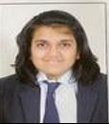
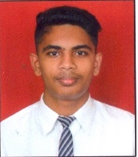
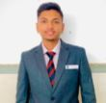
Volume 01 Issue 05
Vision and Mission of the Department
VISION:
To produce professional skilled civil engineers to face the challenges in the engineering field and pursue higher education.
MISSION:
M1:To provide quality infrastructure in the support of a conducive learning environment.
M2:To inculcate the practices towards employability, entrepreneurship and higher education.
M3:To develop a positive attitude, professional and social skills
Civil engineering Toppers SYCE S-23
Sr. No | Name of Student | Enrolment No | Class | % | Photos
1 | DANDGAVAL POOJA MANOJ | 2111670119 | SYCE | 80.63
2 | GAIKWAD OMKAR SANTOSH | 2111670120 | SYCE | 79.38
3 | PHADOL ADITYA DATTATRAY | 2111670060 | SYCE | 75.00

Slide 10
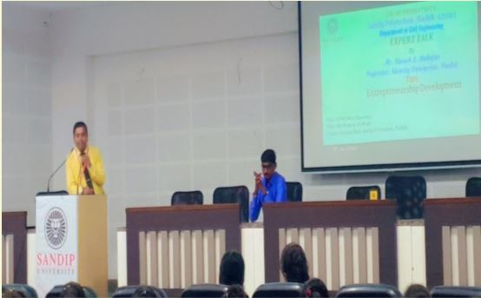
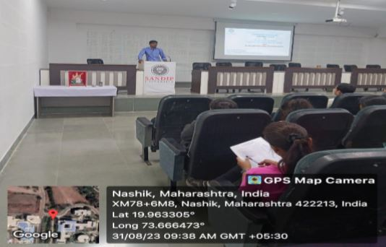
Volume 01 Issue 05
Vision and Mission of the Department
VISION:
To produce professional skilled civil engineers to face the challenges in the engineering field and pursue higher education.
MISSION:
M1:To provide quality infrastructure in the support of a conducive learning environment.
M2:To inculcate the practices towards employability, entrepreneurship and higher education.
M3:To develop a positive attitude, professional and social skills
Expert Lectures
Expert Lecture on Entrepreneurship Development
Name of Event:
Expert lecture on Entrepreneurship development .
Date of Expert Lecture:-
31.08.2023
Resource Person:-
Mr. L. G. Mahajan
Participants:-
SYCE & TYCE Students
Objectives:-
The guest lecture was about ‘Entrepreneurship Development’. In his talk, he introduced himself and explained how he achieved these feet in his life. He further explained about How to become proficient in endeavours of life. The outcome of his lecture with respect to context proved to be efficient and informative at the same time.

Slide 11
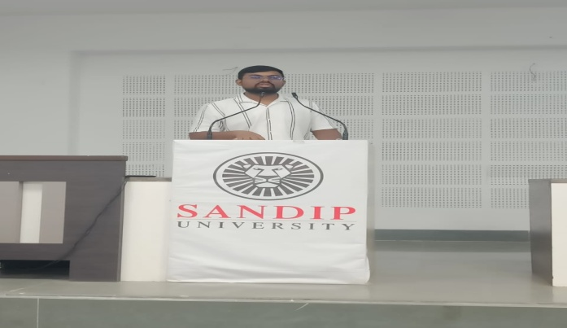
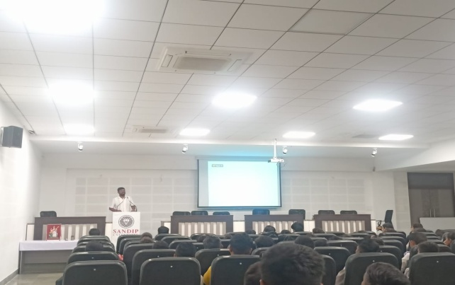
Volume 01 Issue 05
Vision and Mission of the Department
VISION:
To produce professional skilled civil engineers to face the challenges in the engineering field and pursue higher education.
MISSION:
M1:To provide quality infrastructure in the support of a conducive learning environment.
M2:To inculcate the practices towards employability, entrepreneurship and higher education.
M3:To develop a positive attitude, professional and social skills
Expert Lectures
Expert Lecture on Geotechnical Investigation for foundation
Name of Event:
Expert Lecture on Geotechnical Investigation for foundation.
Date of Expert Lecture:-
31.08.2023
Resource Person:-
Prof. S. D. Turakane
Participants:-
SYCE & TYCE Students
Objectives:-
These investigations help understand the geological and geotechnical properties of the site.
These investigations also assess groundwater conditions, including depth, flow, and potential effects on foundation stability.
Ultimately, the data collected from geotechnical investigations is used to design appropriate foundations that can safely support the intended structure while considering factors like soil bearing capacity, settlement, and groundwater conditions.

Slide 12
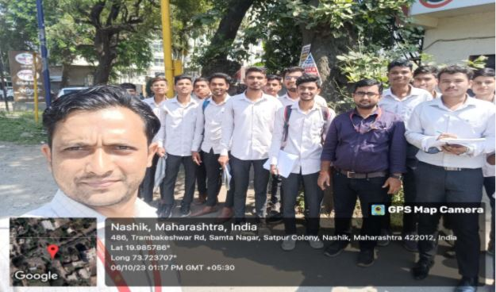
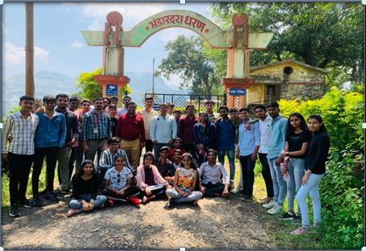
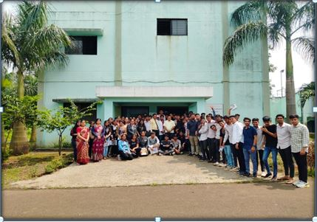
Volume 01 Issue 05
Vision and Mission of the Department
VISION:
To produce professional skilled civil engineers to face the challenges in the engineering field and pursue higher education.
MISSION:
M1:To provide quality infrastructure in the support of a conducive learning environment.
M2:To inculcate the practices towards employability, entrepreneurship and higher education.
M3:To develop a positive attitude, professional and social skills
Industrial Visits
Traffic Volume Study
Sewage Treatment Plant
Bhandardhara Dam
Name of Event:
Traffic Volume Study Visit.
Date of Visit:-
06.10.2023
Visit Location:-
Papaya Signal, Satpur, Nashik
Participants:-
SYCE & TYCE Students
Objectives:-
To understand the Traffic Volume importance at intersections and use of count of vehicles (use of data while design roads).
Name of Event:
Visit to Sewage Treatment Plant Gangapur , Nashik.
Date of Visit:-
30.09.2023
Visit Location:-
Sewage Treatment Plant Gangapur, Nashik
Participants:-
SYCE & TYCE Students
Objectives:-
To study the working of Sewage treatment plant.
To study the various component of Sewage treatment plant
Name of Event:
Earthen Dam Visit.
Date of Visit:-
07.10.2023
Visit Location:-
Bhandardara Dam, Rajur , Ahmednagar.
Participants:-
TYCE Students
Objectives:-
To study the working of Gravity Dam.
To study the various component of Gravity Dam.

Slide 13
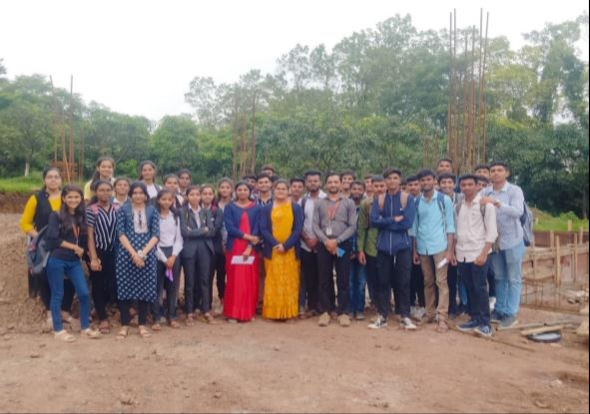
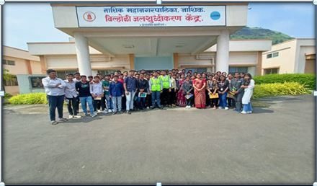
Volume 01 Issue 05
Vision and Mission of the Department
VISION:
To produce professional skilled civil engineers to face the challenges in the engineering field and pursue higher education.
MISSION:
M1:To provide quality infrastructure in the support of a conducive learning environment.
M2:To inculcate the practices towards employability, entrepreneurship and higher education.
M3:To develop a positive attitude, professional and social skills
Industrial Visits
Sub Structure visit at sandip foundation campus
Waste water treatment plant vilholi
Name of Event:
Visit to Sub Structure visit at sandip foundation campus.
Date of Visit:-
08.08.2023
Visit Location:-
Sandip Foundation Campus, Near Olive Canteen, Nashik.
Participants:-
SYCE & TYCE Students
Objectives:-
Identify components of substructure of building.
Propose suitable type of foundation of building structures.
Name of Event:
Visit to Waste water treatment plant vilholi.
Date of Visit:-
30.09.2023
Visit Location:-
Water treatment Plant Vilholi , Nashik .
Participants:-
TYCE Students
Objectives:-
To study the working of Water treatment plant.
To study the various component of Water treatment plant.
To describe the process of treating water.

Slide 14
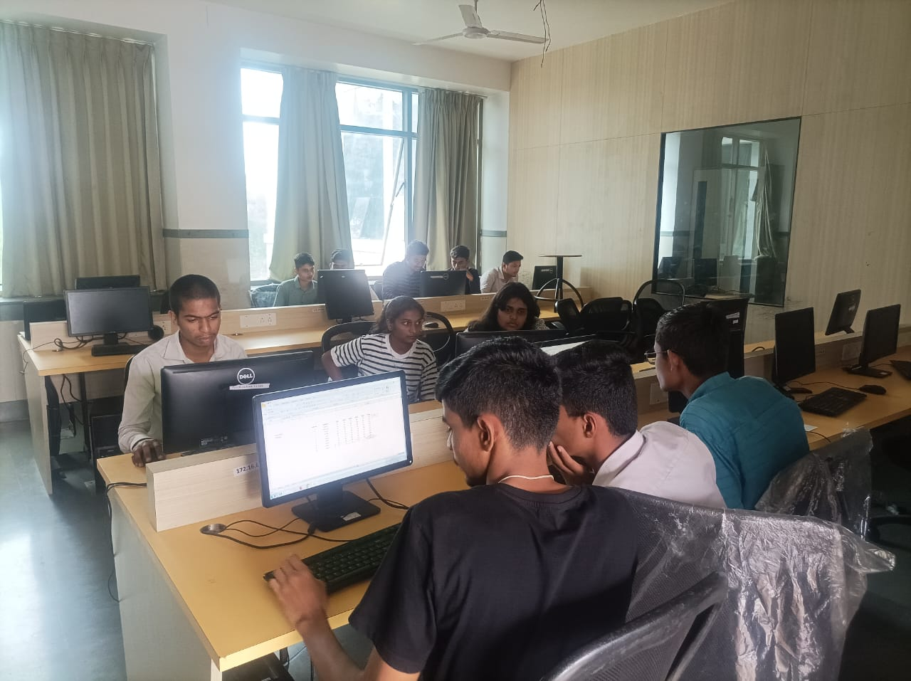
Volume 02 Issue 05
Vision and Mission of the Department
VISION:
To produce professional skilled civil engineers to face the challenges in the engineering field and pursue higher education.
MISSION:
M1:To provide quality infrastructure in the support of a conducive learning environment.
M2:To inculcate the practices towards employability, entrepreneurship and higher education.
M3:To develop a positive attitude, professional and social skills
Six day’s Workshop on Advance Excel Spread sheet
Six day’s Workshop on Advance Excel Spread sheet
Name of Event:
Six day’s Workshop on Advance Excel Spread sheet. .
Date of Expert Lecture:-
21.09.2023
Location:-
Sandip Polytechnic Building CAD Lab.
Participants:-
TYCE Students
Objectives:-
Discuss strategies for collaborating on Excel workbooks, sharing data securely, and protecting sensitive information using permissions and encryption.
Teach participants advanced formulas such as array formulas and logical functions to perform complex calculations efficiently.

Slide 15
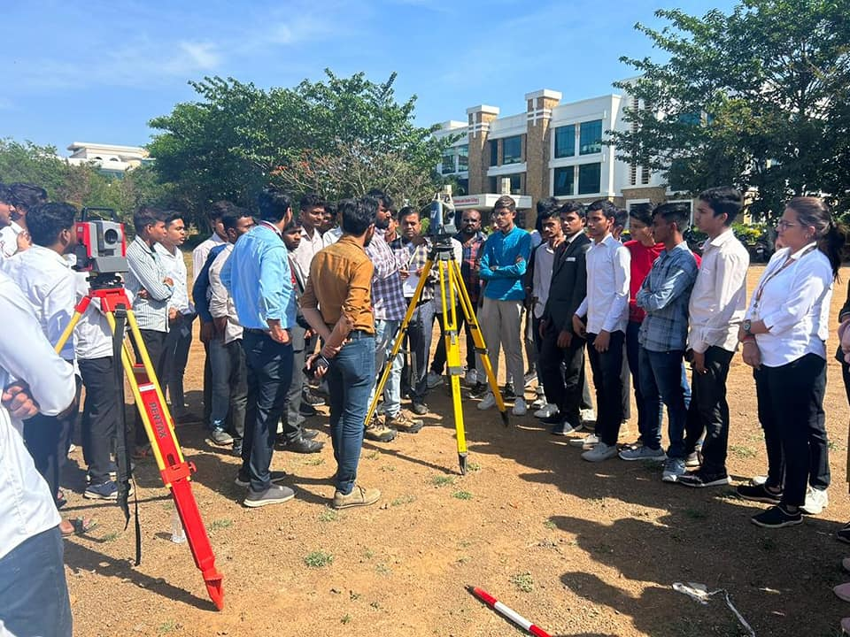
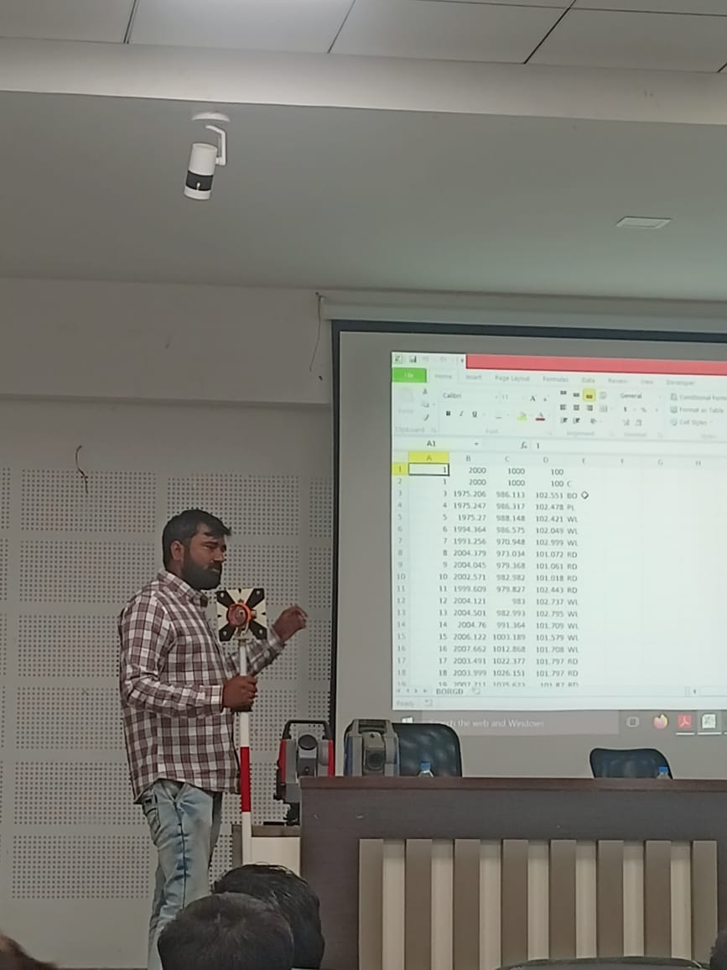
Volume 02 Issue 05
Vision and Mission of the Department
VISION:
To produce professional skilled civil engineers to face the challenges in the engineering field and pursue higher education.
MISSION:
M1:To provide quality infrastructure in the support of a conducive learning environment.
M2:To inculcate the practices towards employability, entrepreneurship and higher education.
M3:To develop a positive attitude, professional and social skills
One day Workshop on Total Station
Total Station Workshop
Name of Event:
One day Workshop on Total Station. .
Date of Expert Lecture:-
05.09.2023
Location:-
Sandip Polytechnic Parking Ground.
Participants:-
SYCE & TYCE Students
Objectives:-
Participants should learn about the different parts of a total station and their functions, including the telescope, electronic distance measurement (EDM) unit, display panel, and data storage capabilities.
Educate participants on common issues that may arise during total station operation and how to troubleshoot them.

Slide 16
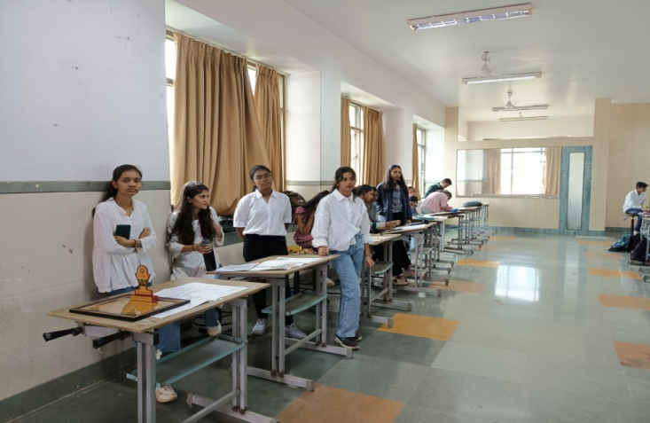
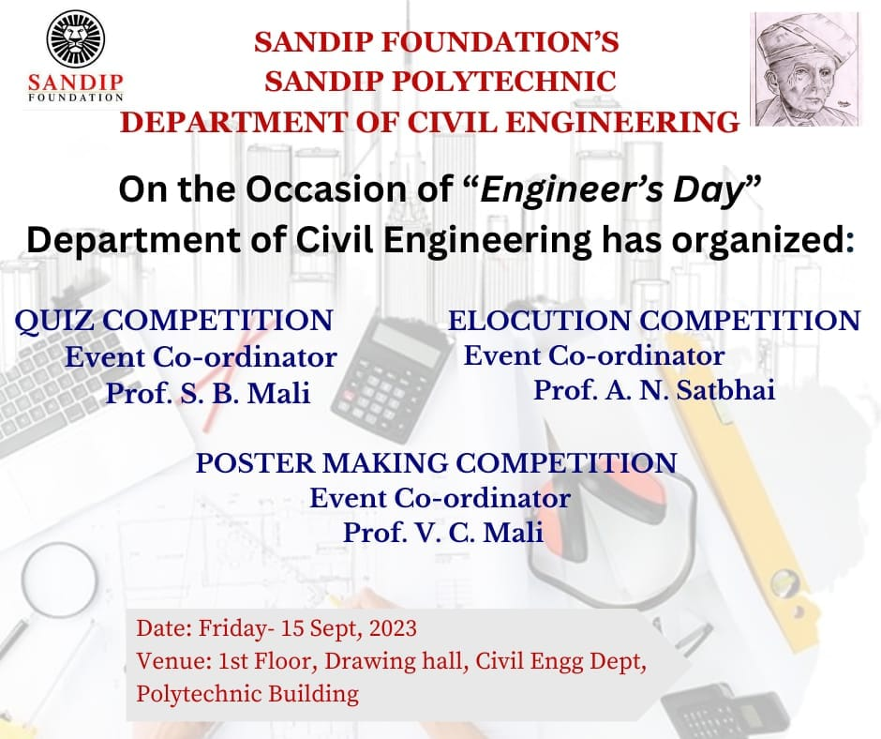
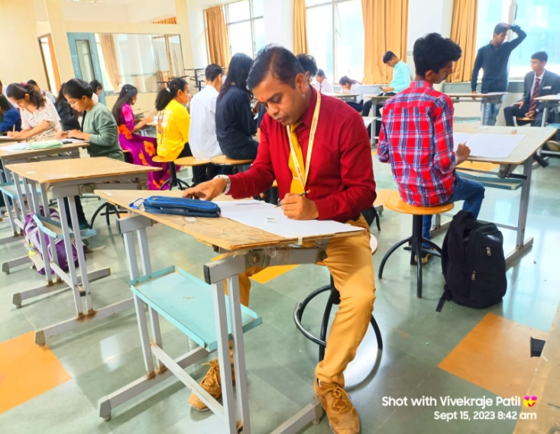
Volume 01 Issue 05
Vision and Mission of the Department
VISION:
To produce professional skilled civil engineers to face the challenges in the engineering field and pursue higher education.
MISSION:
M1:To provide quality infrastructure in the support of a conducive learning environment.
M2:To inculcate the practices towards employability, entrepreneurship and higher education.
M3:To develop a positive attitude, professional and social skills
Competition
Poster Making Competition
Name of Event:
Poster Making Competition. .
Date of Expert Lecture:-
15.09.2023
Location:-
Sandip Polytechnic Building Drawing Hall.
Participants:-
TYCE & SYCE Students
Objectives:-
Poster competitions can serve as educational tools, especially in schools and universities. They provide opportunities for students to research topics, learn about different art techniques, and develop their artistic skills in a fun and interactive way.
Poster-making competitions serve as a platform for personal growth, community engagement, and positive social impact.

Slide 17
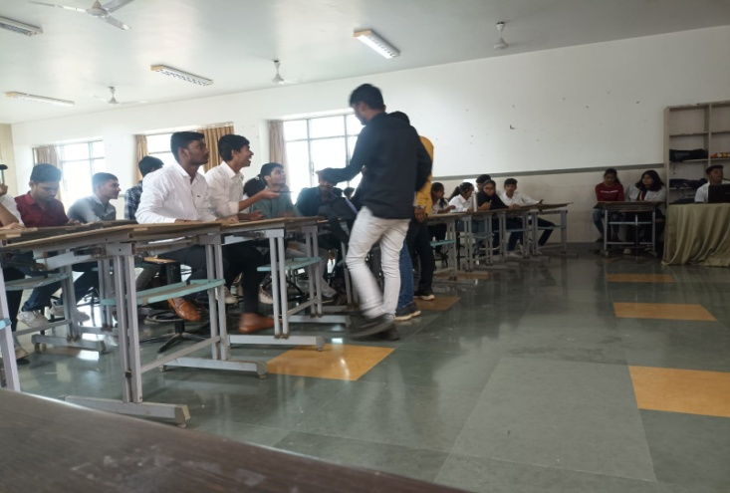
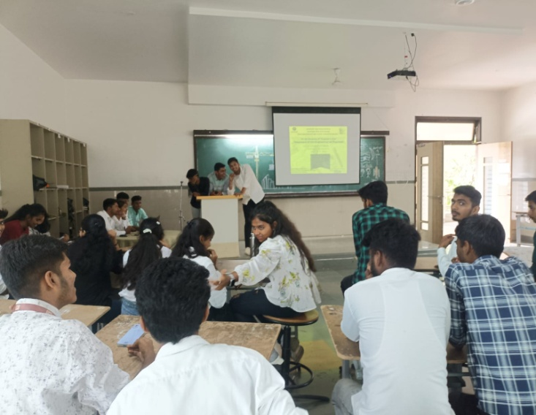
Volume 01 Issue 05
Vision and Mission of the Department
VISION:
To produce professional skilled civil engineers to face the challenges in the engineering field and pursue higher education.
MISSION:
M1:To provide quality infrastructure in the support of a conducive learning environment.
M2:To inculcate the practices towards employability, entrepreneurship and higher education.
M3:To develop a positive attitude, professional and social skills
Competition
Quiz Competition
Name of Event:
Quiz Competition. .
Date of Expert Lecture:-
15.09.2023
Location:-
Sandip Polytechnic Class room 203.
Participants:-
TYCE & SYCE Students
Objectives:-
The primary objective of quiz competitions is to encourage participants to acquire knowledge across different subjects or themes.
Quiz questions often require participants to analyze information, make connections, and apply reasoning skills to arrive at answers. This process fosters critical thinking abilities, helping participants become better problem solvers.
Engaging in quiz competitions can enhance participants' ability to retain information and recall it when needed.

Slide 18
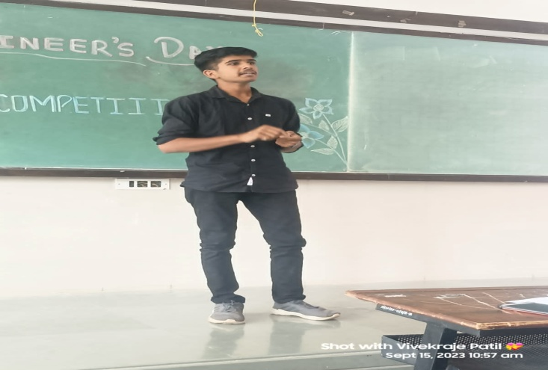
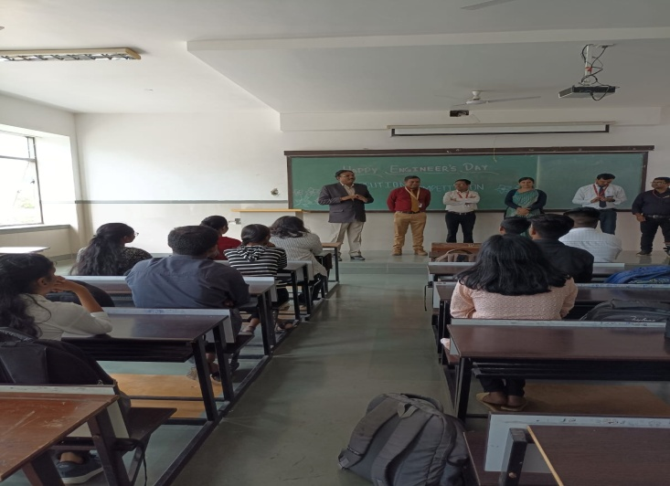
Volume 01 Issue 05
Vision and Mission of the Department
VISION:
To produce professional skilled civil engineers to face the challenges in the engineering field and pursue higher education.
MISSION:
M1:To provide quality infrastructure in the support of a conducive learning environment.
M2:To inculcate the practices towards employability, entrepreneurship and higher education.
M3:To develop a positive attitude, professional and social skills
Competition
Elocution Competition
Name of Event:
Elocution Competition. .
Date of Expert Lecture:-
15.09.2023
Location:-
Sandip Polytechnic Class room 204.
Participants:-
TYCE & SYCE Students
Objectives:-
Elocution competitions aim to enhance participants' ability to communicate effectively.
Through practicing and delivering speeches, participants learn to articulate their thoughts clearly, express themselves confidently, and engage their audience.
Public speaking can be daunting for many people, but elocution competitions provide a supportive environment for participants to overcome their fears and build confidence in their speaking abilities. Successfully delivering speeches in front of an audience boosts self-assurance and self-esteem..

Slide 19
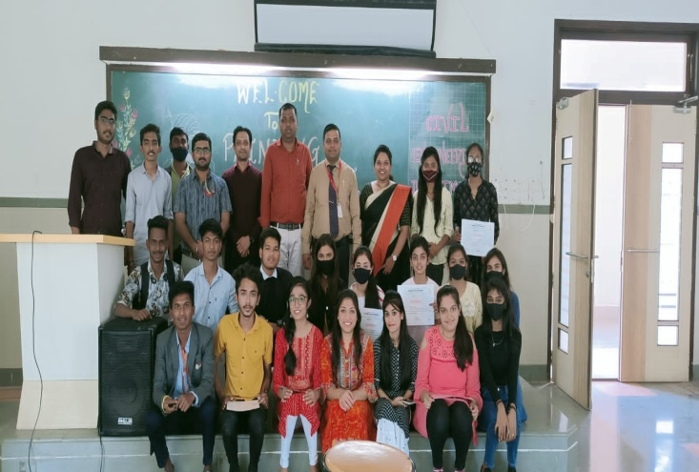
Volume 01 Issue 05
Vision and Mission of the Department
VISION:
To produce professional skilled civil engineers to face the challenges in the engineering field and pursue higher education.
MISSION:
M1:To provide quality infrastructure in the support of a conducive learning environment.
M2:To inculcate the practices towards employability, entrepreneurship and higher education.
M3:To develop a positive attitude, professional and social skills
Competition
Paper Presentation Competition
Name of Event:
Paper Presentation Competition. .
Date of Expert Lecture:-
15.09.2023
Location:-
Sandip Polytechnic Class room 204.
Participants:-
TYCE & SYCE Students
Objectives:-
Elocution competitions aim to enhance participants' ability to communicate effectively.
Through practicing and delivering speeches, participants learn to articulate their thoughts clearly, express themselves confidently, and engage their audience.
Public speaking can be daunting for many people, but elocution competitions provide a supportive environment for participants to overcome their fears and build confidence in their speaking abilities. Successfully delivering speeches in front of an audience boosts self-assurance and self-esteem..

Slide 20
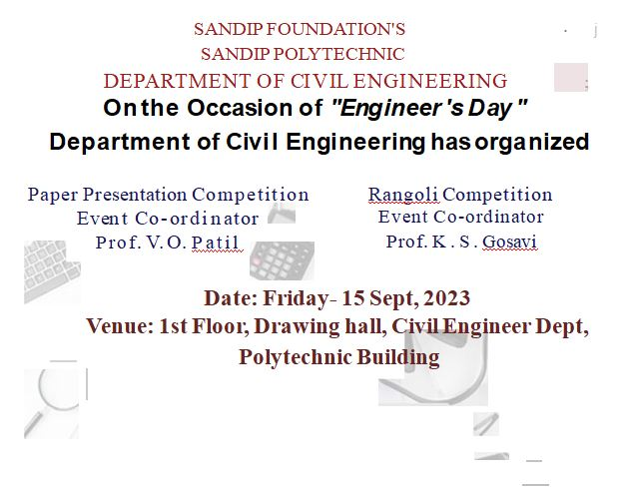
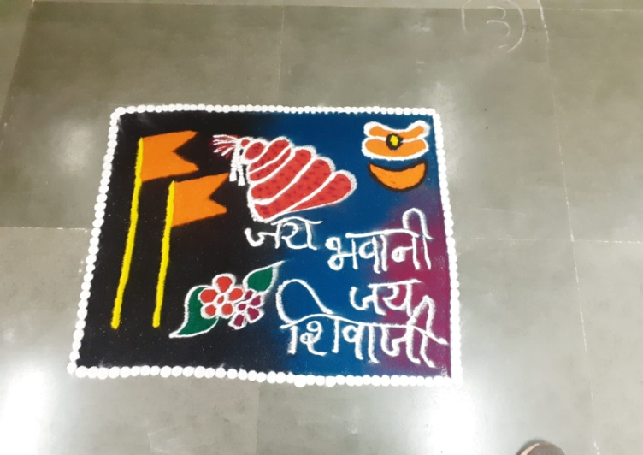
Volume 01 Issue 05
Vision and Mission of the Department
VISION:
To produce professional skilled civil engineers to face the challenges in the engineering field and pursue higher education.
MISSION:
M1:To provide quality infrastructure in the support of a conducive learning environment.
M2:To inculcate the practices towards employability, entrepreneurship and higher education.
M3:To develop a positive attitude, professional and social skills
Competition
Rangoli Competition
Name of Event:
Rangoli Competition. .
Date of Expert Lecture:-
15.09.2023
Location:-
Sandip Polytechnic Class room 101.
Participants:-
TYCE & SYCE Students
Objectives:-
Rangoli is a traditional art form in many cultures, particularly in India. Competitions help in preserving and promoting this traditional art form, passing it down through generations.
Engaging in a competition setting encourages participants to hone their artistic skills.
These competitions provide a platform for celebrating cultural diversity and heritage.

Slide 21

Volume 01 Issue 05
Vision and Mission of the Department
VISION:
To produce professional skilled civil engineers to face the challenges in the engineering field and pursue higher education.
MISSION:
M1:To provide quality infrastructure in the support of a conducive learning environment.
M2:To inculcate the practices towards employability, entrepreneurship and higher education.
M3:To develop a positive attitude, professional and social skills
Competition
Paper Presentation Competition
Name of Event:
Paper Presentation Competition. .
Date of Expert Lecture:-
15.09.2023
Location:-
Sandip Polytechnic Class room 101.
Participants:-
TYCE & SYCE Students
Objectives:-
Paper presentations facilitate the exchange of ideas and perspectives among scholars from different institutions and disciplines.
Paper presentations often include case studies, practical applications, and lessons learned from real-world experiences.
Paper presentations often include case studies, practical applications, and lessons learned from real-world experiences.

